Slide 1
Mix-Precision Stochastic Quantization of
Activations during Backpropagation
Heidelberg University
Institute of Computer Engineering
Hardware and Artificial Intelligence (HAWAII) Lab
Master's Thesis
Jiufeng Li
Supervisor: Prof. Dr. Holger Fröning
08/09/2025

Slide 2
Contents
Background
Motivation
Contributions
Discussion & Outlook
References
Notes:
Let me walk you through what we'll cover
Background: AlexNet cnn, forward quantization, backward quantization, determininistic vs stochastic quantization, prior work (related work …) ,

Slide 3
Background

Slide 4
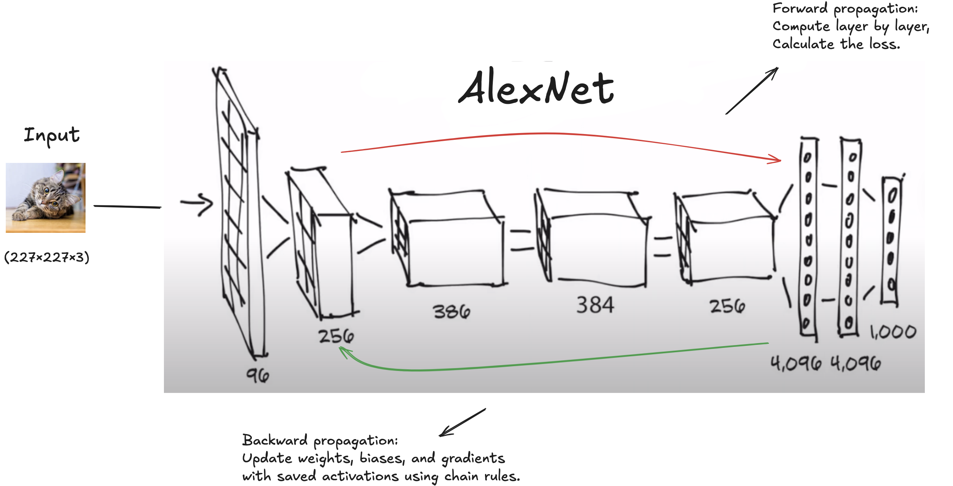
Classic CNN architecture
Fig.1. The Architecture of AlexNet
Background
Notes:
Before diving into our quantization work, let me provide some essential background on classic CNN architectures, using AlexNet as our illustrative example.
Forward Propagation
Here we see AlexNet processing a 227×227×3 input image through a series of convolutional and fully connected layers.
The network progressively transforms the input through multiple layers
Notice how feature map dimensions change: 96 channels, then 256, 384, and finally to fully connected layers with 4,096 neurons
The forward pass is straightforward - just compute layer by layer until we get our final 1,000-class output
Backward Propagation:
To compute gradients for each layer's weights, we need the activations from the previous layer
The memory challenge in training
Now here's where it gets interesting for our research. During training, we need both forward AND backward propagation.
The forward pass computes the loss, but that's only half the story.
To update weights during backpropagation, we need to store ALL intermediate activations from the forward pass.
Look at these numbers: 96, 256, 384, 256 feature maps, plus two 4,096-dimensional vectors.
These saved activations often consume MORE memory than the model parameters themselves.

Slide 5
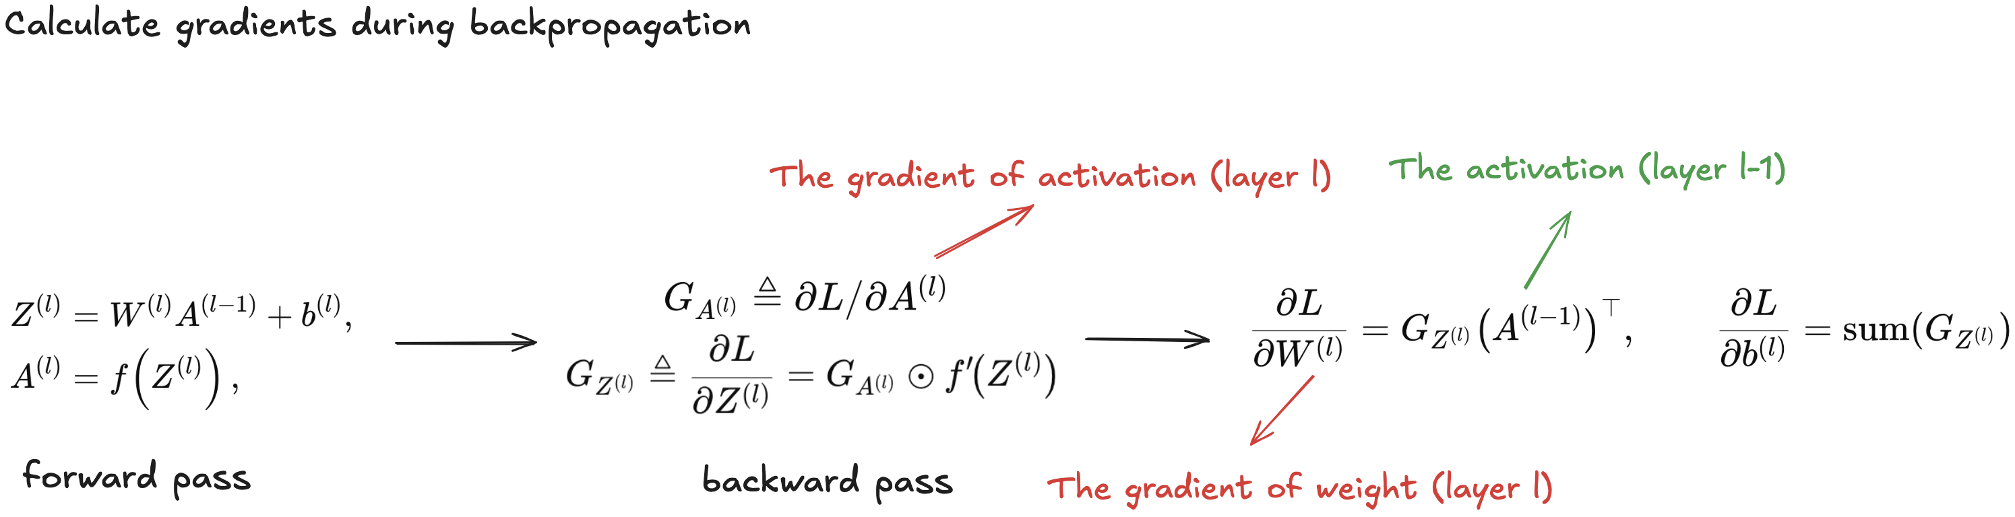
Classic CNN architecture
Forward pass: compute layer outputs and the final loss L from inputs; cache the intermediates (activations) needed for gradients.
Backward pass:
start from ∂L/∂output and, by the chain rule, compute per-layer parameter gradients (e.g., ∂L/∂W, ∂L/∂b), input gradients to send to the previous layer, then hand gradients to the optimizer to update parameters.
e.g., how to calculate the gradient during backpropagation? (take l-th layer as an example)
Background
Notes:
FP:
First, we compute the pre-activation
Then we apply the activation function
BP: Now, let's see why we need those saved activations. The backward pass uses the chain rule to compute gradients
First, we receive the gradient from the layer above
Then we compute the gradient with respect to the pre-activation
Now comes the critical part - computing weight gradients
See this? We need A^(l-1) - the activation from the PREVIOUS layer that we saved during forward pass!”
Key insights:
This equation reveals our memory challenge. To compute weight gradients, we need the activations from the forward pass. For deep networks,
this means storing hundreds of activation tensors in full precision.

Slide 6
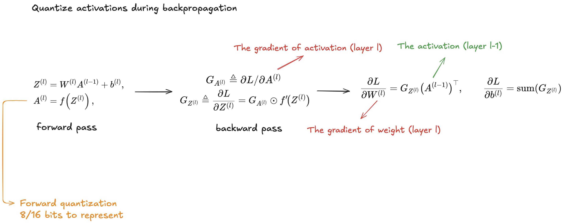
Forward Quantization
Background
Notes:
Quantize activations during the forward pass
DeepSeek V3.1 Key Innovations in 8-bit Floating Point (FP8) Learning

Slide 7
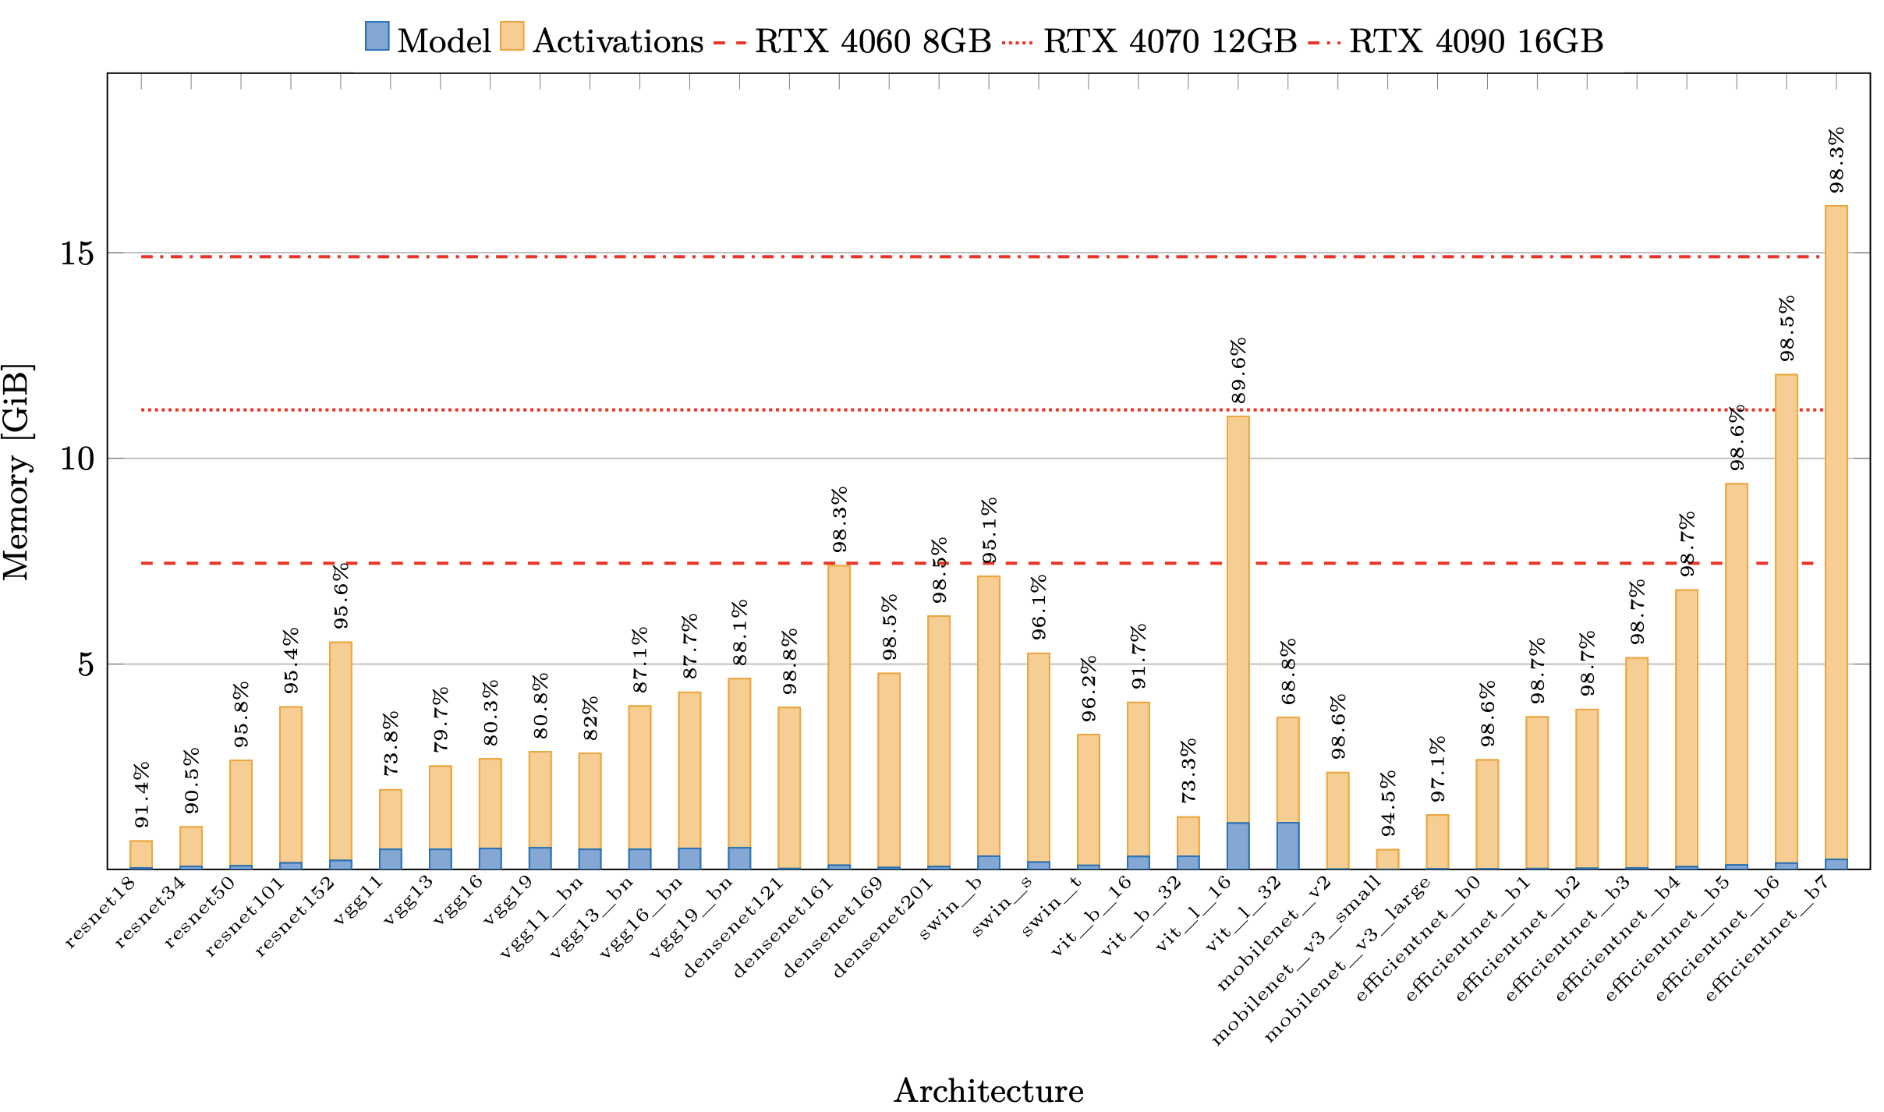
Backpropagation Quantization
Barley et al. 2024
Fig.2. Memory footprint during training of common vision architectures split into model parameters and activations.
Background
Notes:
Before I show you backpropagation quantization, let me first establish why activation quantization is so important. This chart from Barley et al. 2024 reveals a critical insight that motivated our entire research direction.
What we're looking at here is the memory breakdown during training for dozens of popular CNN architectures. Each bar is split into two parts:
Blue portion: Model parameters (weights and biases)
Orange portion: Activations that must be saved for backpropagation.
ResNet models: Around 90-95% activation memory
EfficientNet variants: 85-90% activation memory
This is counter-intuitive! Most people think model parameters are the memory bottleneck, but it's actually the activations we need to save for gradient computation.
Look what this means for practical training:
Many modern architectures exceed 8GB" - can't train on RTX 4060
Larger models push beyond 12GB" - need expensive RTX 4090s

Slide 8
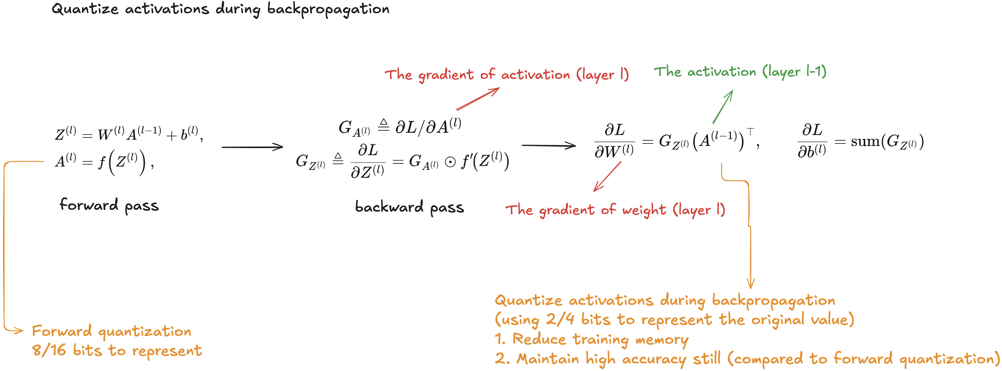
Backpropagation Quantization
Background
Notes:
Now we arrive at the heart of our research - backpropagation quantization. This is where we achieve dramatic memory savings by pushing quantization to extremely low bit-widths while maintaining accuracy. This is fundamentally different from anything shown before.

Slide 9
Activations Quantization
Activation quantization maps floating-point activations to a low-bit representation.
Forward activations quantization(inference/training): used to speed up compute or shrink feature maps during forward passes.
Backward activations quantization (training-only): stored during forward and reused, and quantized for the backward pass.
Background

Slide 10
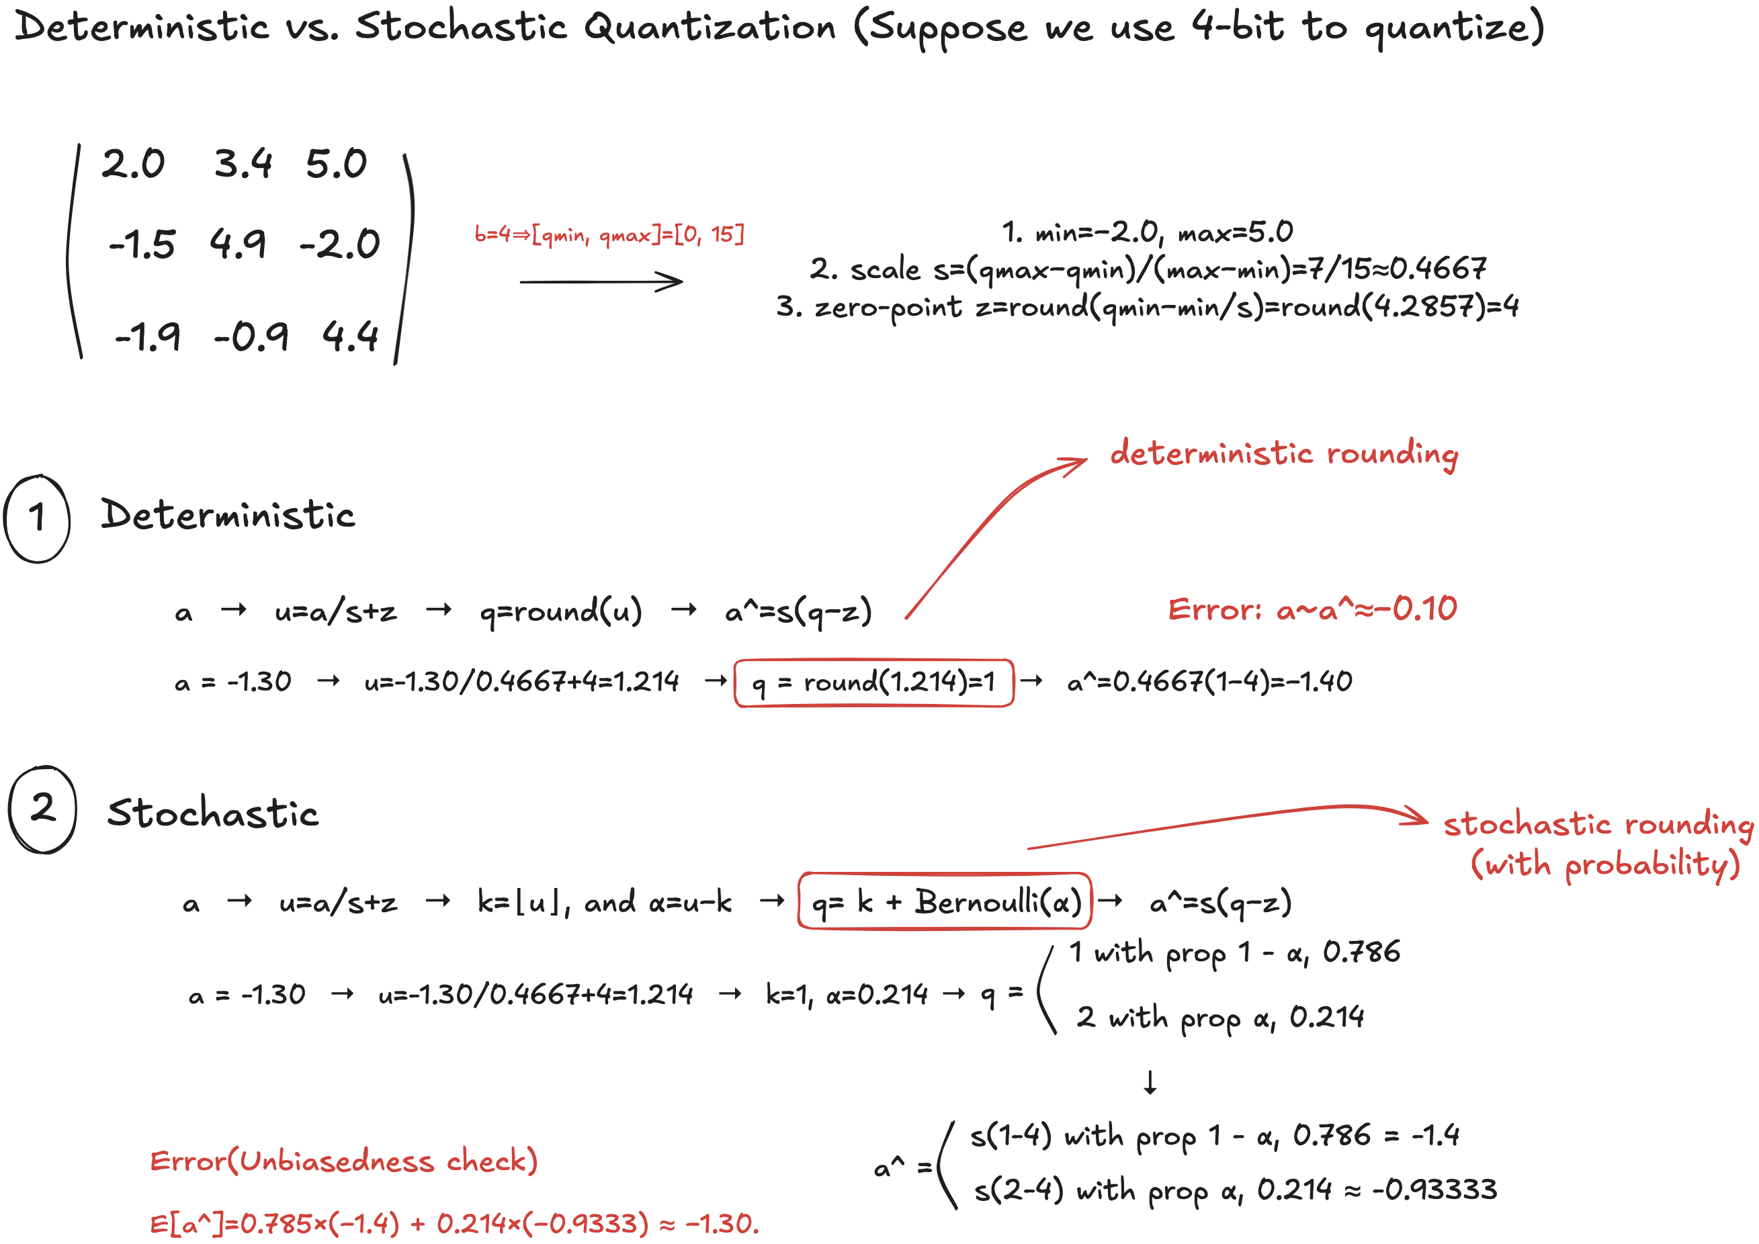
Deterministic vs. Stochastic Quantization
Background
Notes:
Now let me show you the mathematical heart of our contribution. This slide demonstrates why stochastic quantization fundamentally outperforms deterministic quantization, using a concrete 4-bit example that you can follow step by step.
Range: [qmin=-2.0, qmax=5.0]" - covers our activation range
Scale: s = 7/15 = 0.4667" - maps our range to quantization levels
Zero-point: z = 4" - handles the offset for asymmetric range
Deterministic
Let's trace through deterministic quantization for the value a = -1.30:"Step-by-Step Calculation:"Normalize: u = a/s + z" → u = -1.30/0.4667 + 4 = 1.214
"Round deterministically: q = round(1.214) = 1" ← Key step!
"Dequantize: a* = s(q-z)" → a* = 0.4667(1-4) = -1.40
Notice that the rounding ALWAYS goes the same way for this value. This creates systematic bias.
Now let's see how stochastic quantization handles the same value:"The Key Difference - Probabilistic Rounding:
1."Same normalization: u = 1.214"
"Find boundaries: k = floor(1.214) = 1, fractional part α = 0.214"
"Stochastic choice based on α":
"Probability 1-α = 0.786" → round down to 1
"Probability α = 0.214" → round up to 2
Training Implications:"Deterministic errors accumulate" → gradient drift over training
"Stochastic errors cancel out" → correct gradient estimates in expectation

Slide 11
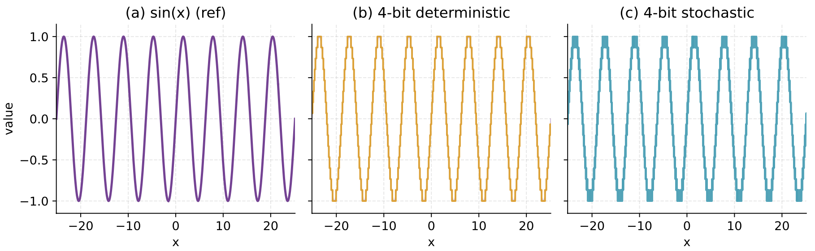
Deterministic vs. Stochastic Quantization
Fig.3. Tripanel illustration of 4-bit quantization of sin(x) over a wide range.
(a) Reference signal. (b) Deterministic rounding. (c) Stochastic rounding
Background
Notes:
the sin(x) function over the range from -20 to 20

Slide 12
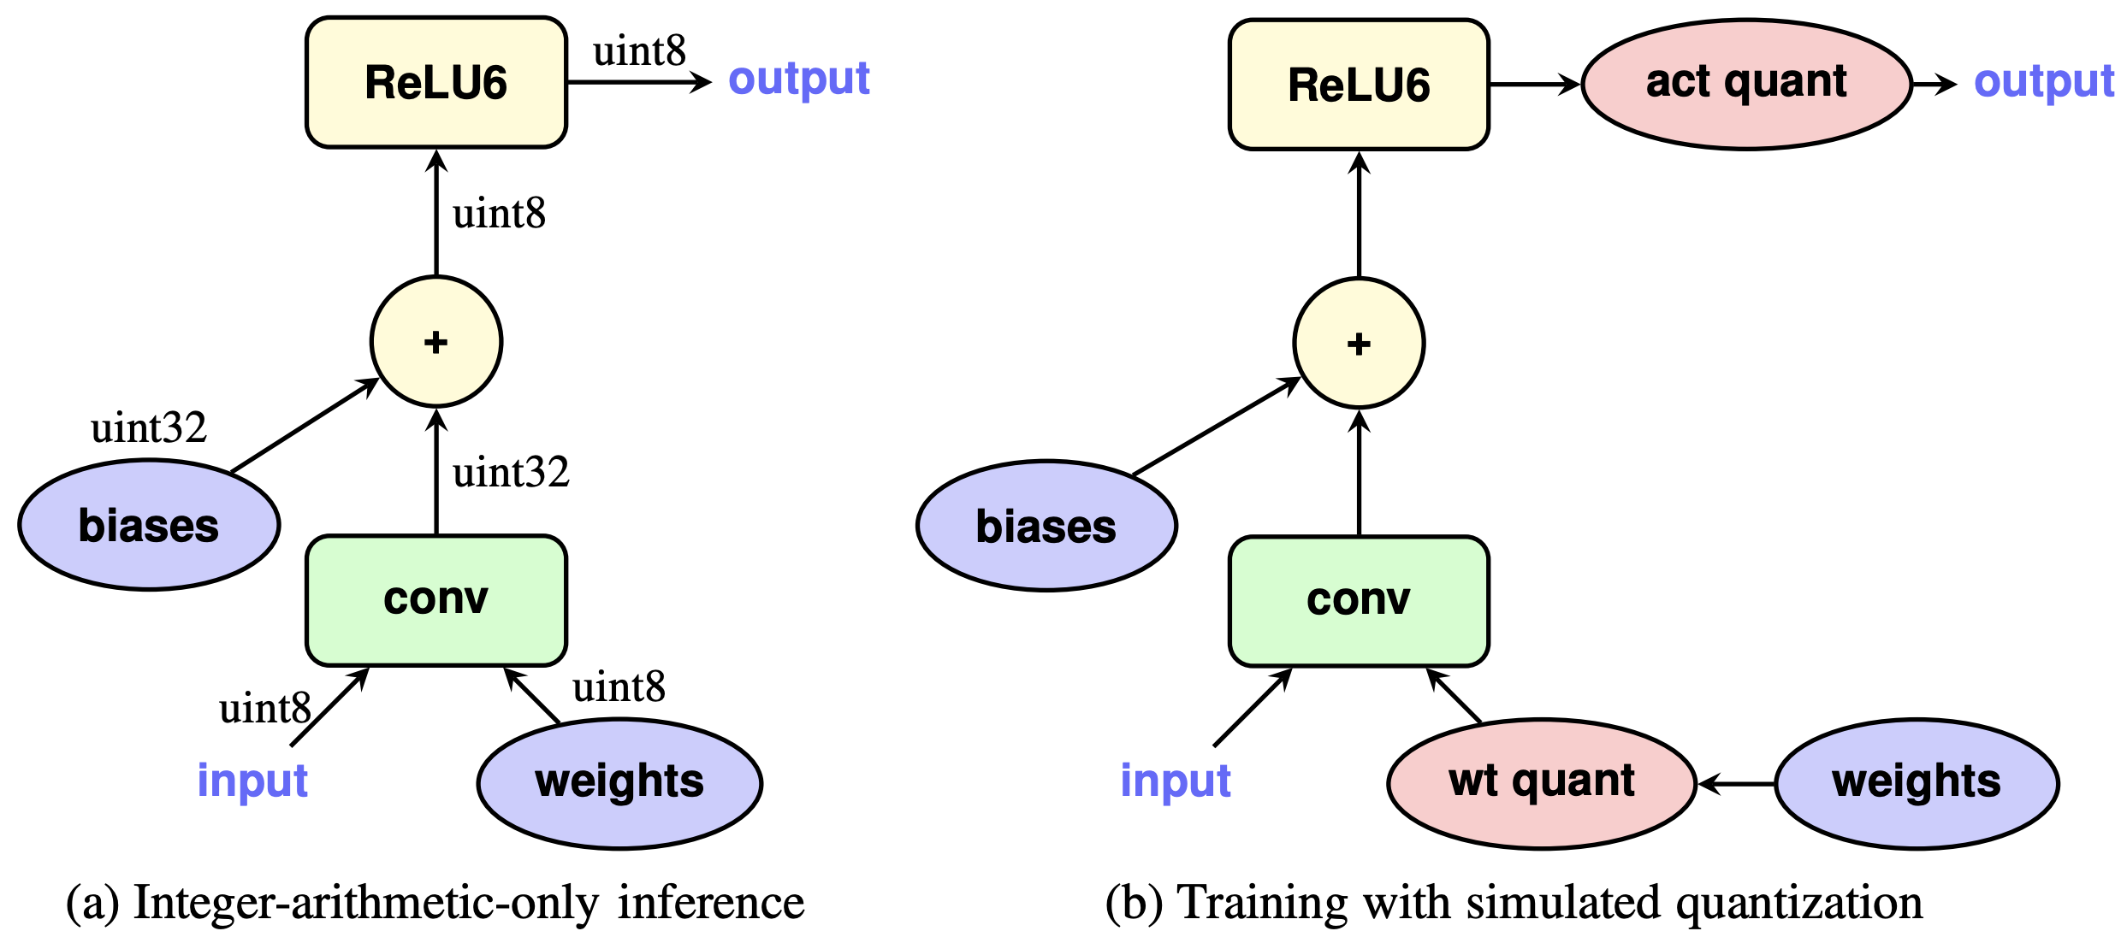
CNN Quantization: From Inference to QAT
- Inference Quantization
Approach: Integer-arithmetic-only inference with 8-bit (or lower) activations/weights
Method: Post-training quantization, calibration datasets, hardware-optimized kernels
Key Papers: Jacob et al. 2018 - Integer Quantization; Krishnamoorthi 2018 - Quantizing Deep CNNs
Jacob et al. 2018
Fig.4. Integer-arithmetic-only quantization. a) Integer-arithmetic-only inference of a convolution layer. The input and output are represented as 8-bit integers according to equation b). Training with simulated quantization of the convolution layer.
Background
Notes:
Key Takeaway 1: Inference Quantization is Mature
Inference quantization is a solved problem. As shown here, we can successfully run entire networks using 8-bit integers for both weights and activations during inference.
But look carefully - QAT still uses uint32 for internal computations and storage. The training memory problem remains unsolved!
The Training Memory Bottleneck is Ignored

Slide 13
CNN Quantization: From Inference to QAT
- Forward-Path QAT (Quantization-Aware Training)
Approach: Introduce quantizers in forward path to preserve accuracy at low bit-widths
Method: Fake quantization with Straight-Through Estimator (STE) during training
Key Papers: Bengio et al. 2013 - STE; Hardware-aware QAT (Wang et al. 2019 - HAQ)
Background
Notes:
The Training Memory Bottleneck is Ignored

Slide 14
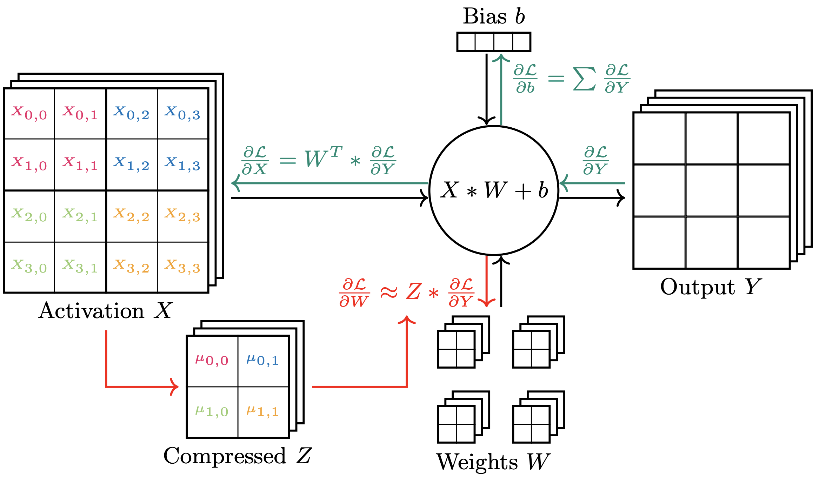
CNN Quantization: From Inference to QAT
- Activation Compression for Backward Pass
Approach: Compress saved activations specifically for gradient computation
Method: Per-group scaling, stochastic rounding, few-bit storage
Key Papers: ActNN (Chen et al. 2021), GACT (Liu et al. 2022), Few-bit Backward (Novikov et al. 2022), Backpropagation with Compressed Activations (Barley et al. 2024)
Barley et al. 2024
Fig.5. Example of activation map compression for a convolutional layer.
Background
Notes:
Really nice way
But we lose some information on activations

Slide 15
Motivation

Slide 16
Limitations of Prior Work
- Problem with Existing Work:
Inference/Forward QAT: Still store full-precision activations for backward pass
Training memory techniques: Limited focus on activation quantization for backpropagation
Missing: Systematic study of stochastic activation quantization with mixed-precision policies
Barley et al. 2024
Fig.6. Memory footprint during training of common vision architectures split into model parameters and activations.
Motivation
Notes:
Improvements, new ways, get rid of biases, mix-precision

Slide 17
Research Motivations & Objectives
Reduce Peak Memory with Low-bit Activations
Use Unbiased Stochastic Rounding
Understand Bucket Size Effects
Mixed-Precision Policies
Implement unbiased stochastic activation quantization within PyTorch
Motivation

Slide 18
Contributions

Slide 19
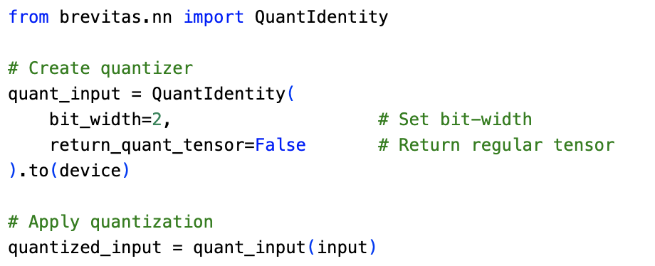
Deterministic Quantization of Activations for Backpropagation
Brevitas
Definition: Open-source PyTorch library for Quantization-Aware Training (QAT)
Features: Flexible quantizer configurations, various bit-widths, and quantization strategies
Advantage: Seamless PyTorch integration, supports custom autograd Functions
Example:
Contribution #1
Notes:
Mature PyTorch library: Well-established, open-source tool for QAT
Flexible configuration: Easy to experiment with different bit-widths and quantization strategies
Production-ready: Seamless PyTorch integration with custom autograd support

Slide 20
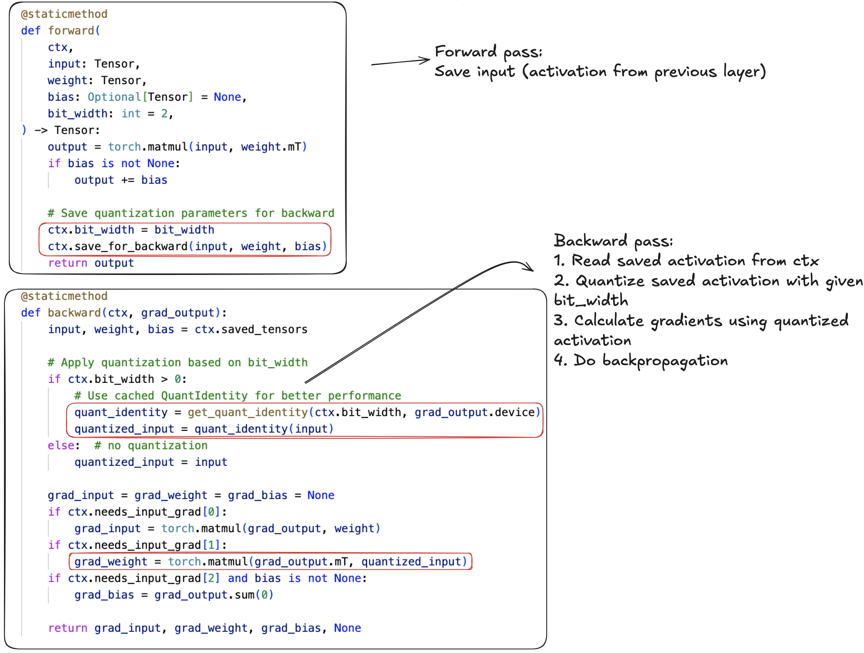
Deterministic Quantization of Activations for Backpropagation
Example:
(Linear layer)
Contribution #1

Slide 21
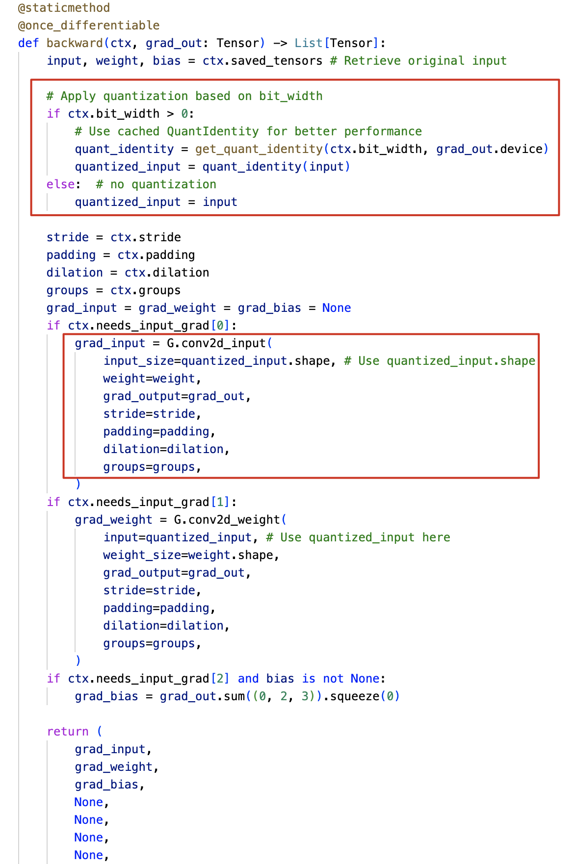
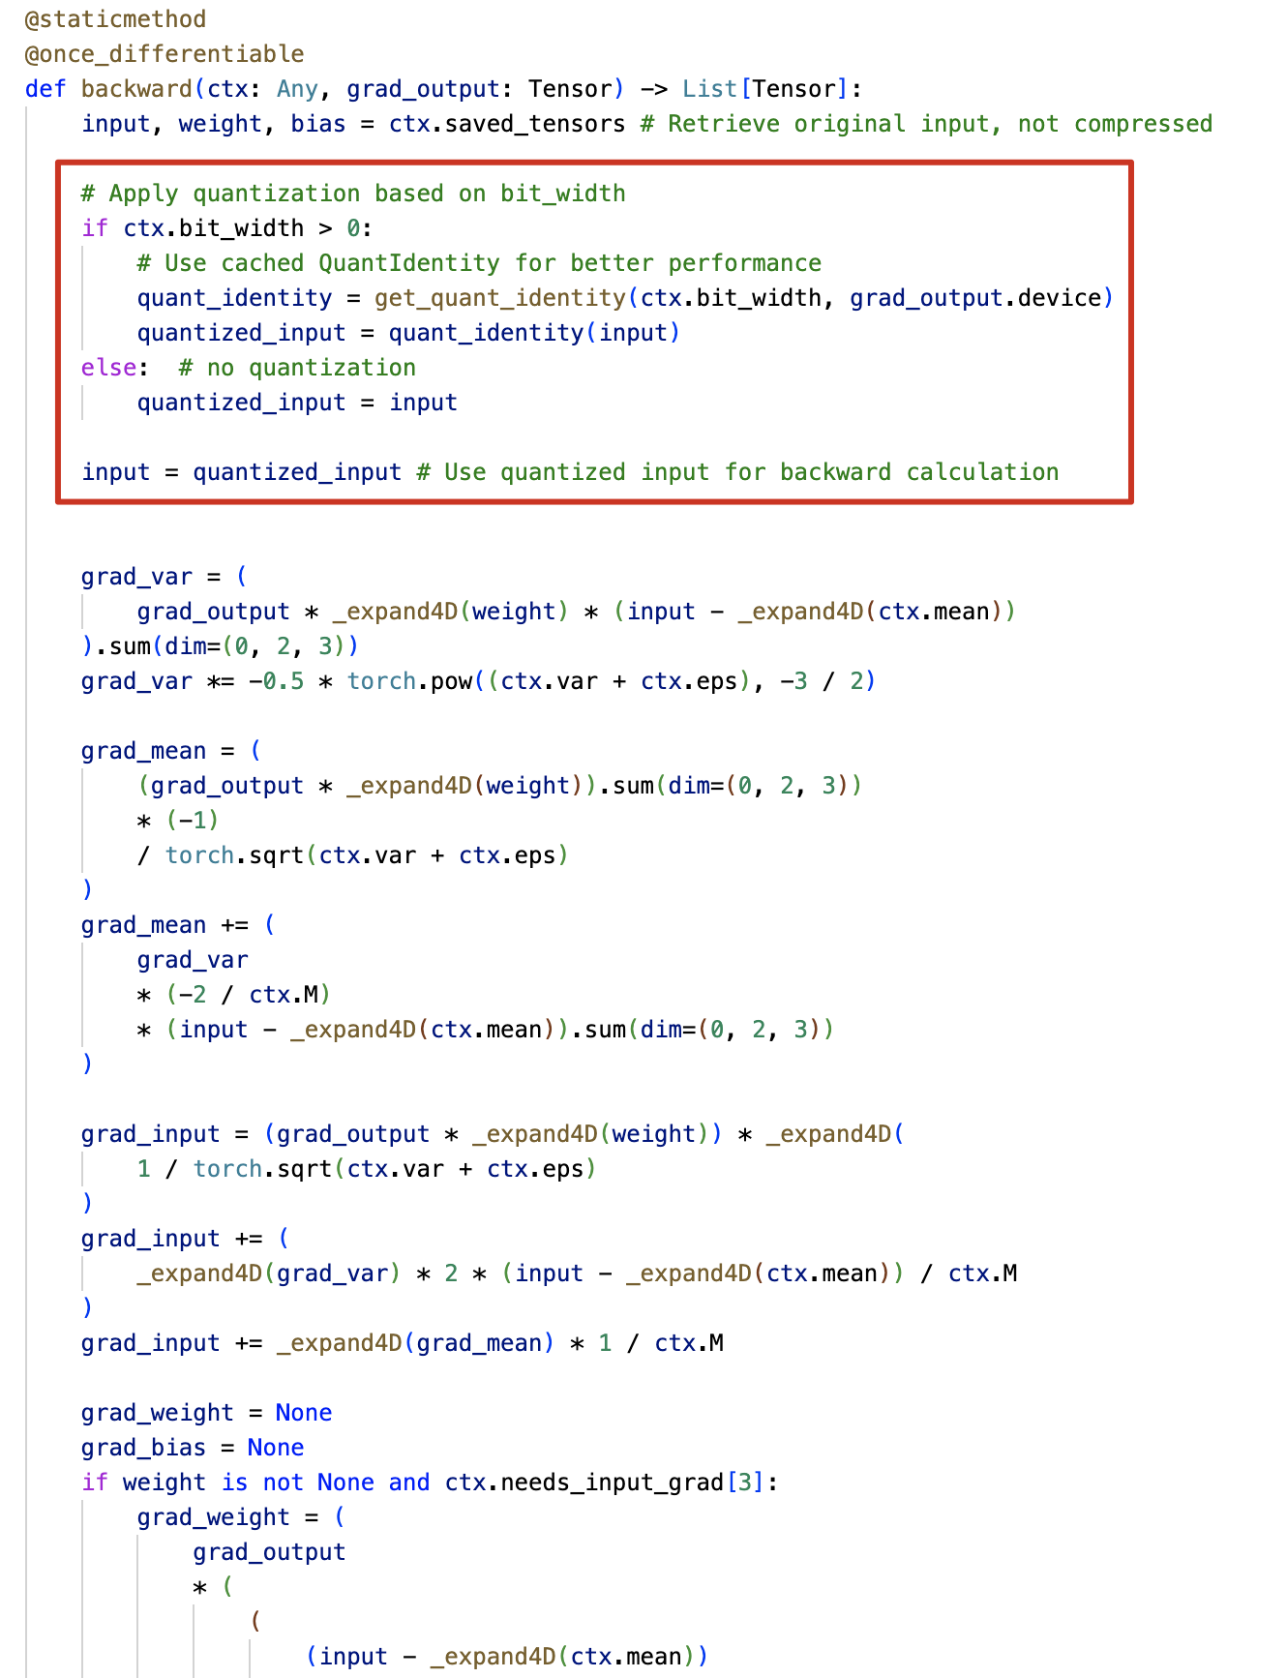
Deterministic Quantization of Activations for Backpropagation
Example:
(Convolutional layer
and Batchnorm layer))
Contribution #1

Slide 22
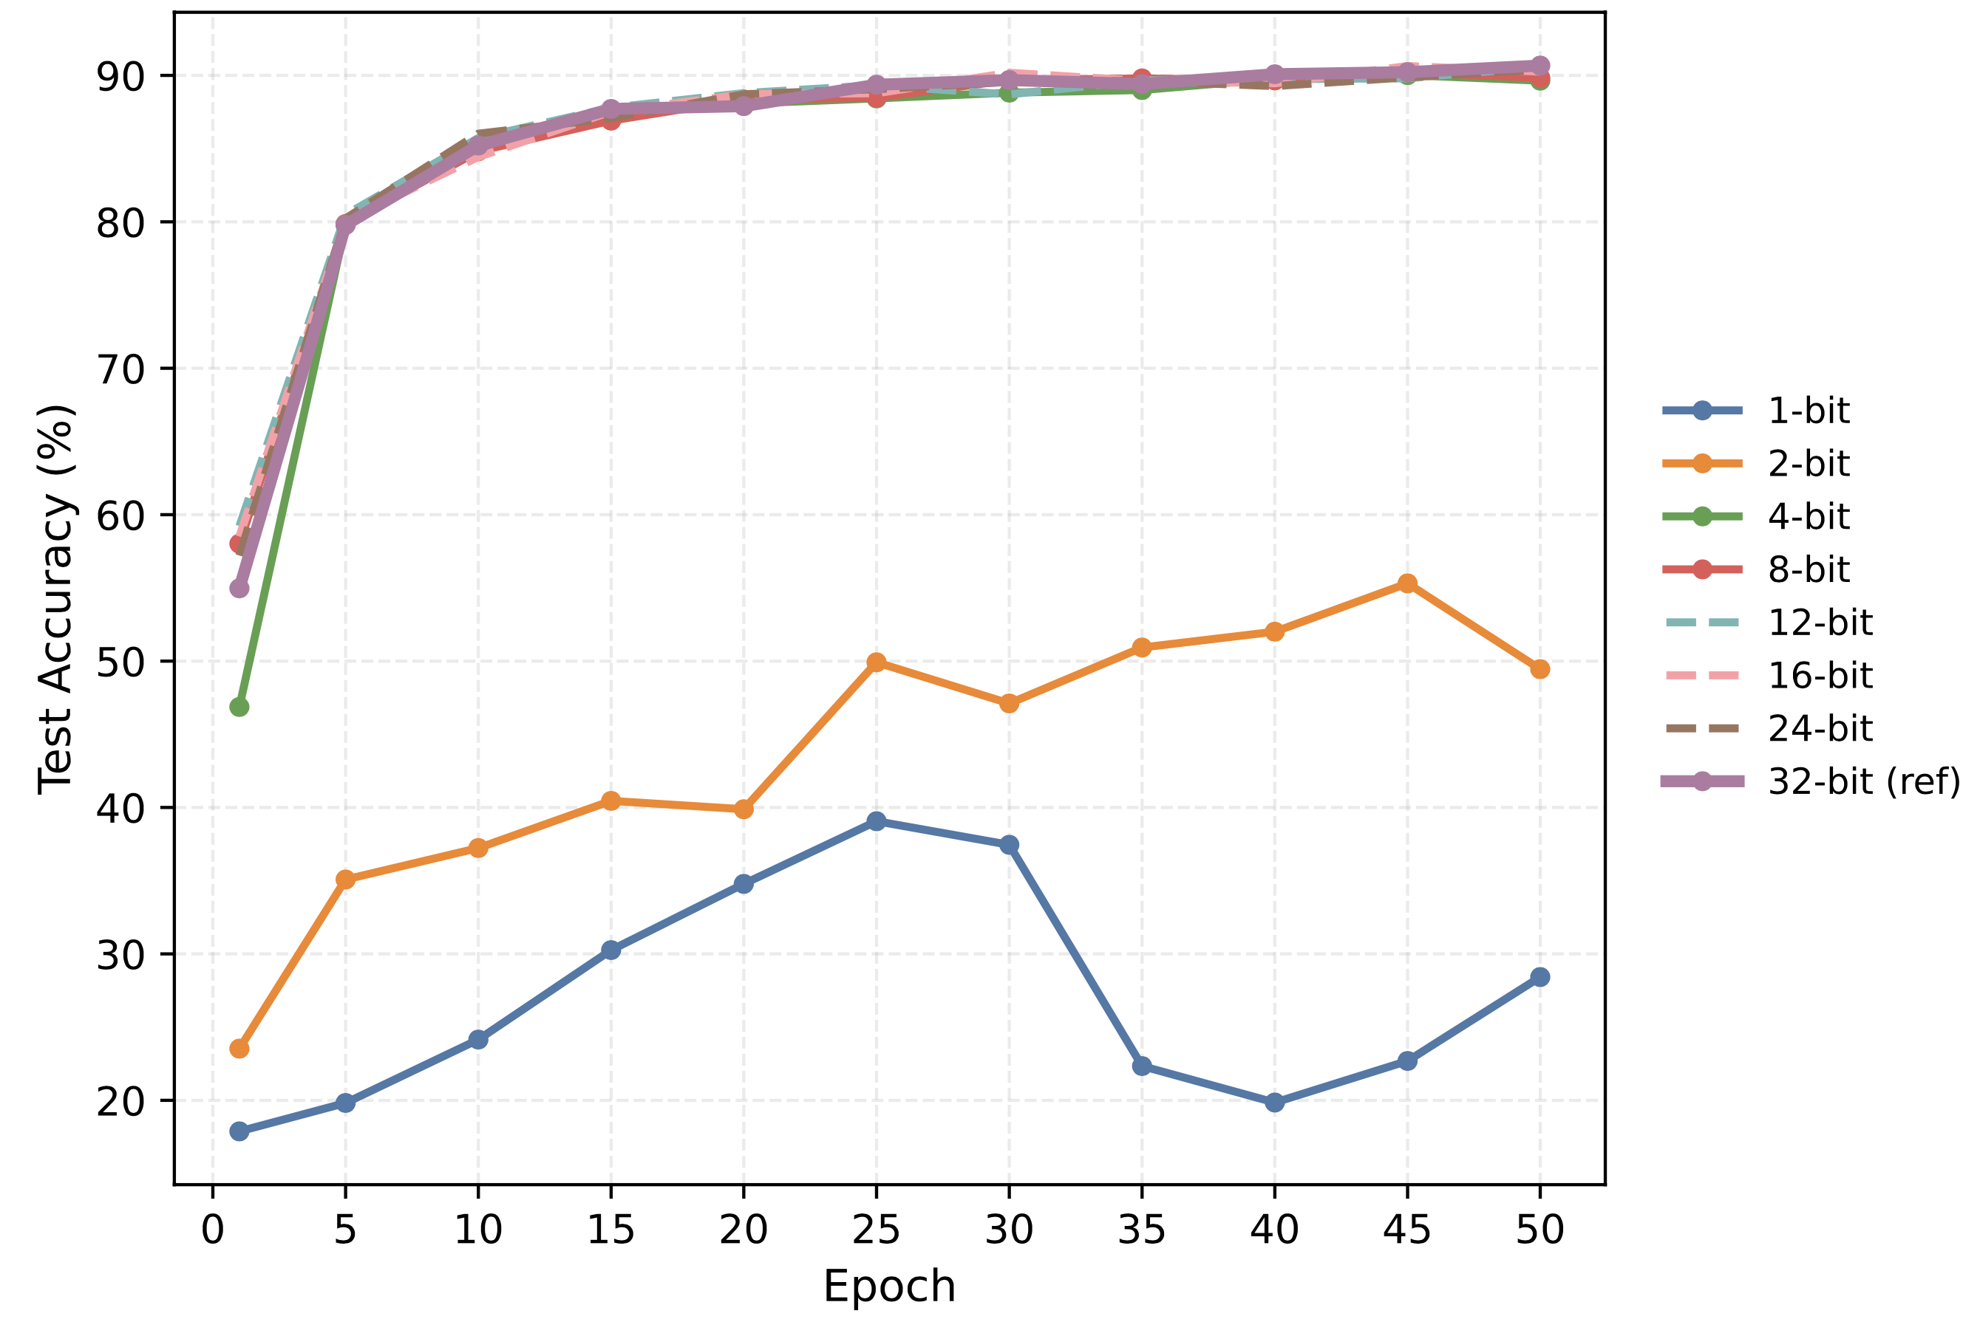
Deterministic Quantization of Activations for Backpropagation
Experiments:
Model: EfficientNetV2-M (Memory-intensive, SOTA CNN architecture)
Dataset: CIFAR-10 (60,000 32×32 color images, 10 classes)
GPU: csg-hawaii cluster(csg-rivulet[01..04], NVIDIA A30, mem: 24576 MiB
Finding:
Accuracy degrades and becomes unstable at very low precision (1-2 bits), but stabilizes at 4-bit and above
, closely catching up to 32-bit.
Fig.7. EcientNetV2 on CIFAR-10 with activation bit-widths from 1 to 32
Contribution #1

Slide 23
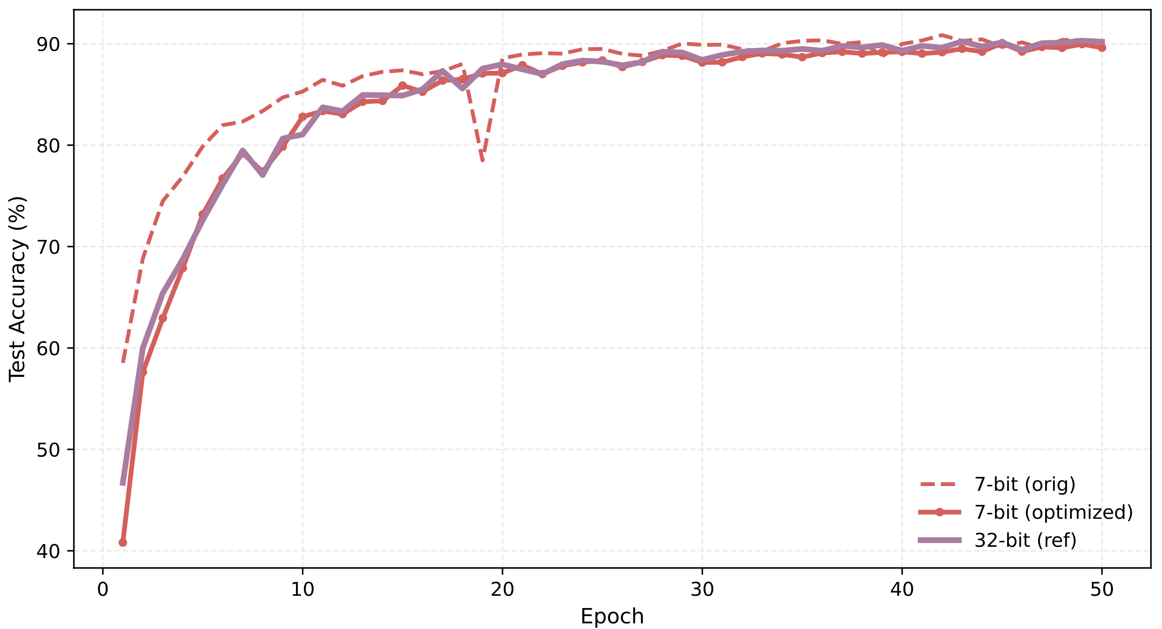
Deterministic Quantization of Activations for Backpropagation
Experiments:
Observation:
Test-accuracy spikes can occur at certain bit-widths during training
Fig.8. 7-bit case on EcientNetV2/CIFAR-10
Contribution #1

Slide 24
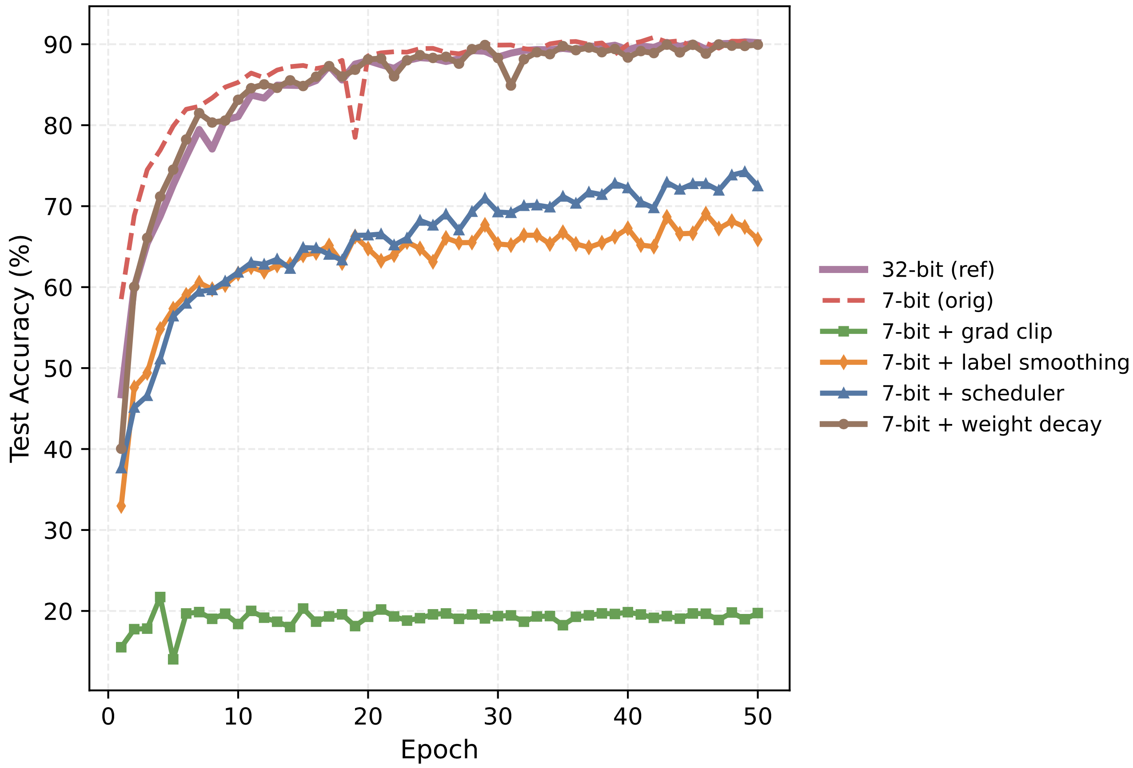
Deterministic Quantization of Activations for Backpropagation
Experiments:
Finding:
Results indicate that weight decay (AdamW) provides the best stabilization of training dynamics and mitigates accuracy degradation associated with low-bit activation quantization, while the other individual strategies (scheduler, label smoothing, gradient clipping) underperform in this setting.
Fig.9. Comparison of four optimization strategies at 7-bit (all with warmup), against 7-bit baseline and 32-bit reference.
Contribution #1
Notes:
Key Finding: Weight Decay is Critical
Point to the Finding Box
"The key insight from this experiment: Weight decay (AdamW) provides the best stabilization for low-bit activation quantization.”
Technical Explanation:”
Regularization effect": Prevents weights from becoming too sensitive to quantization noise
“ Improved generalization": Helps the network learn representations robust to quantization
“ Optimization stability": AdamW's decoupled weight decay is particularly effective

Slide 25
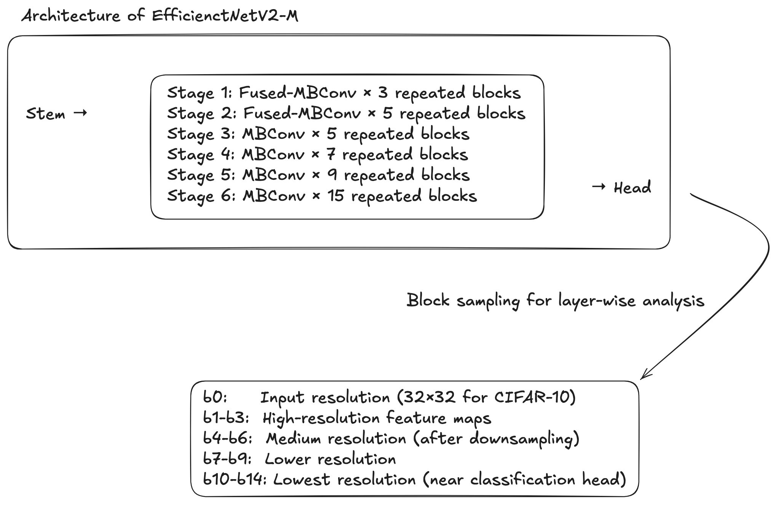
Deterministic Quantization of Activations for Backpropagation
Experiments: Layer-wise sensitivity analysis
Contribution #1
Notes:
Now let me address a critical question for practical deployment: Are some layers more sensitive to quantization than others? If so, we could use mixed-precision strategies where sensitive layers get higher precision.
We're using EfficientNetV2-M, which has a clear hierarchical structure with 6 main stages, each containing multiple repeated blocks.
Stem: Initial processing layer
Stage 1-2: Fused-MBConv blocks (early feature extraction)
Stage 3-6: Standard MBConv blocks (deeper feature processing)
Head: Final classification layers”
With 50+ total blocks, testing every single one would be impractical. Instead, we use strategic sampling:
b0: Input processing (32×32 resolution for CIFAR-10)"
"b1-b3: High-resolution feature maps (early stages)"
"b4-b6: Medium resolution after downsampling"
"b7-b9: Lower resolution (deeper semantic features)"
"b10-b14: Lowest resolution near classification head

Slide 26
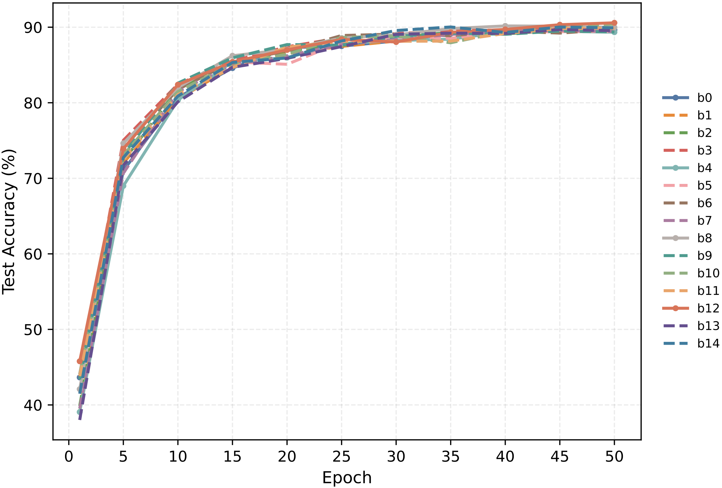
Deterministic Quantization of Activations for Backpropagation
Experiments: Layer-wise sensitivity analysis
Finding:
The results indicate low layer-wise sensitivity of test accuracy to activation quantization: quantizing individual blocks at different stages (at 4-bit) does not yield consistent accuracy improvements nor cause significant degradations compared to the reference.
Fig.10. Per-block (b0-b14) 4-bit activation quantization on EfficientNetV2-M/CIFAR-10.
Contribution #1
Notes:
Now let me address a critical question for practical deployment: Are some layers more sensitive to quantization than others? If so, we could use mixed-precision strategies where sensitive layers get higher precision.
We're using EfficientNetV2-M, which has a clear hierarchical structure with 6 main stages, each containing multiple repeated blocks.
Stem: Initial processing layer
Stage 1-2: Fused-MBConv blocks (early feature extraction)
Stage 3-6: Standard MBConv blocks (deeper feature processing)
Head: Final classification layers”
With 50+ total blocks, testing every single one would be impractical. Instead, we use strategic sampling:
b0: Input processing (32×32 resolution for CIFAR-10)"
"b1-b3: High-resolution feature maps (early stages)"
"b4-b6: Medium resolution after downsampling"
"b7-b9: Lower resolution (deeper semantic features)"
"b10-b14: Lowest resolution near classification head

Slide 27
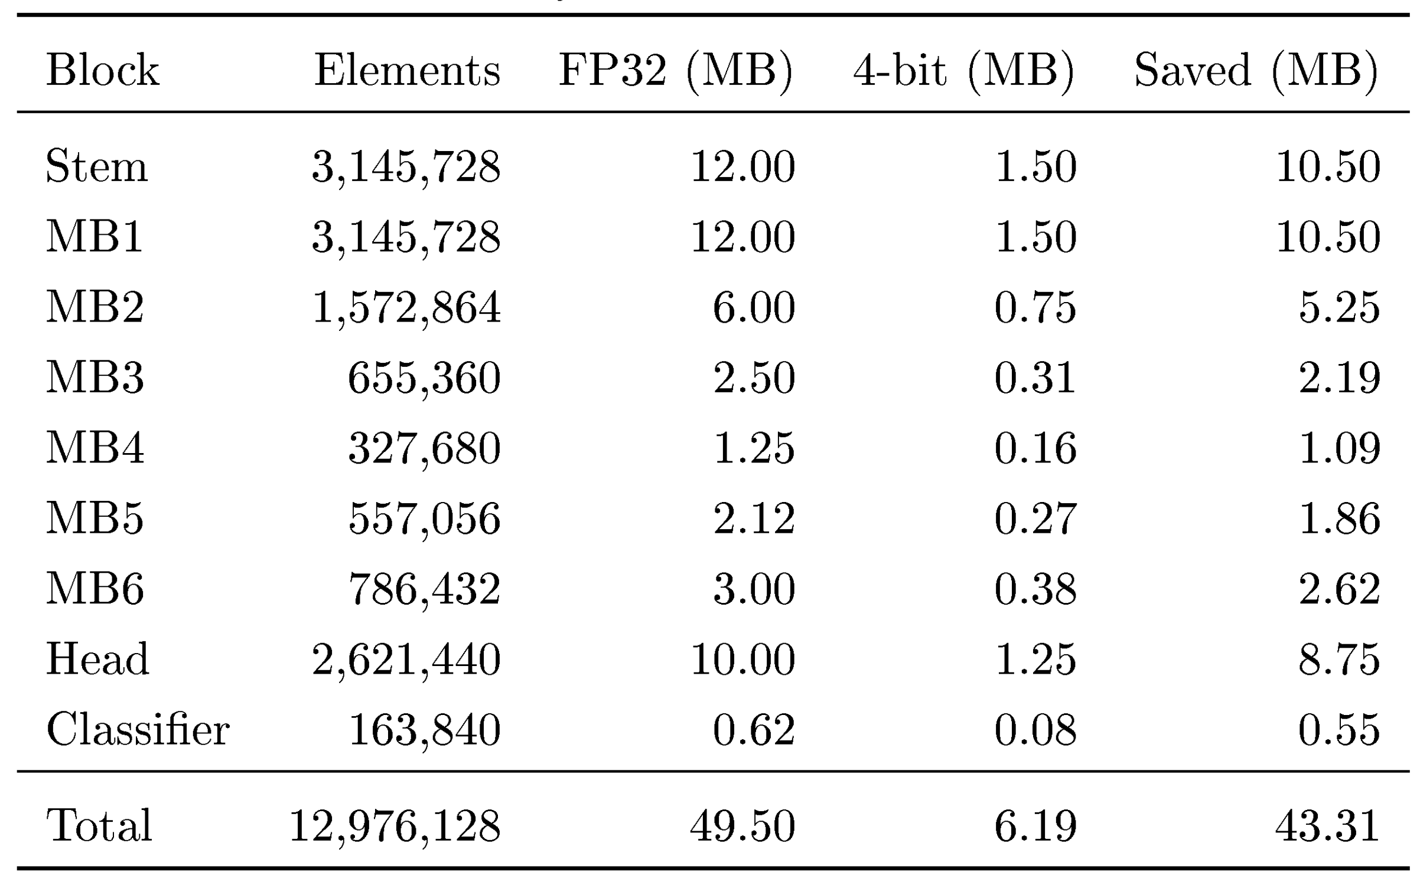
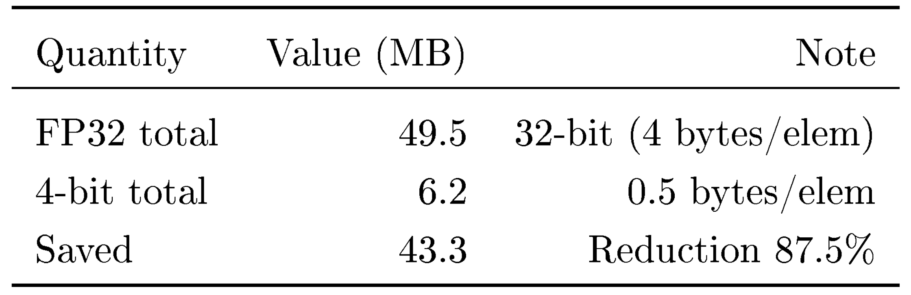
Deterministic Quantization of Activations for Backpropagation
Memory Saving:
Table. 2. Activation memory summary batch.
Table. 1. EfficientNetV2 activation memory by block (per batch). FP32 uses 4 bytes per element; 4-bit uses 0.5 bytes per element. MB computed with 1 MB=10242 bytes.
Contribution #1

Slide 28
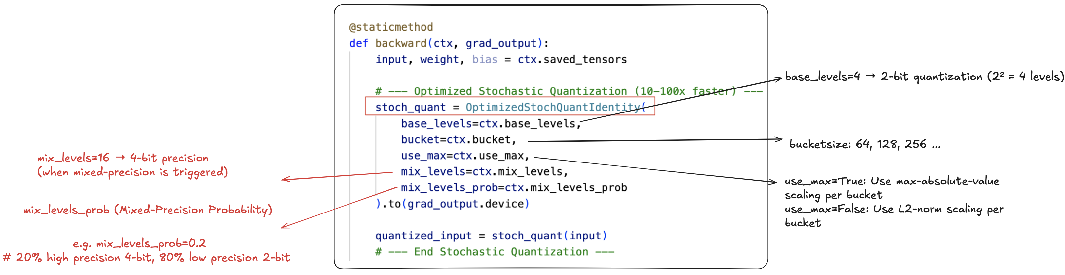
Stochastic Quantization of Activations for Backpropagation
Recap: What is Stochastic Quantization?
Deterministic: Always round to the nearest level → introduces bias
Stochastic: Randomly choose between neighbouring levels → unbiased in expectation
2. Implementation
Contribution #2

Slide 29
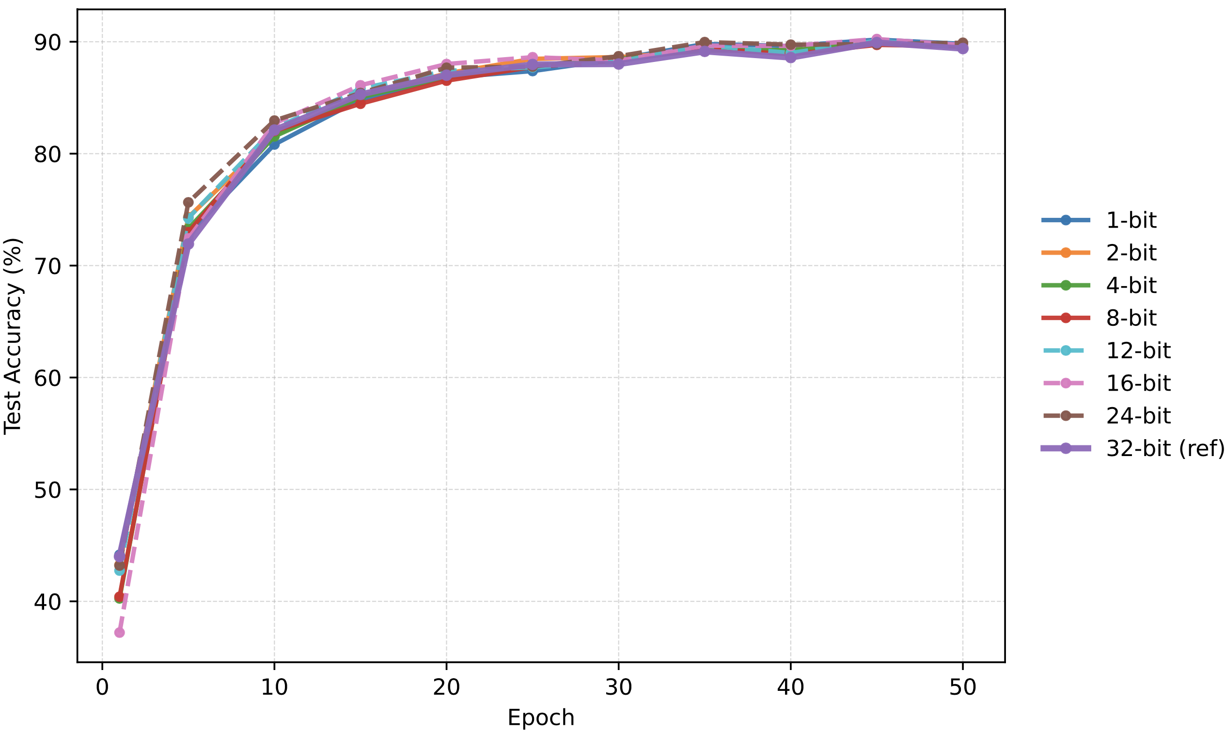
Stochastic Quantization of Activations for Backpropagation
Experiments: Bit-Width Sweep with Stochastic Quantization
Finding:
Even at extremely low bit-widths (1-bit, 2-bit), stochastic quantization demonstrates exceptional performance that closely tracks the 32-bit reference curve.
Fig.11. Stochastic activation quantization from 1 to 32 bits on EfficientNetV2/CIFAR-10
Contribution #2

Slide 30
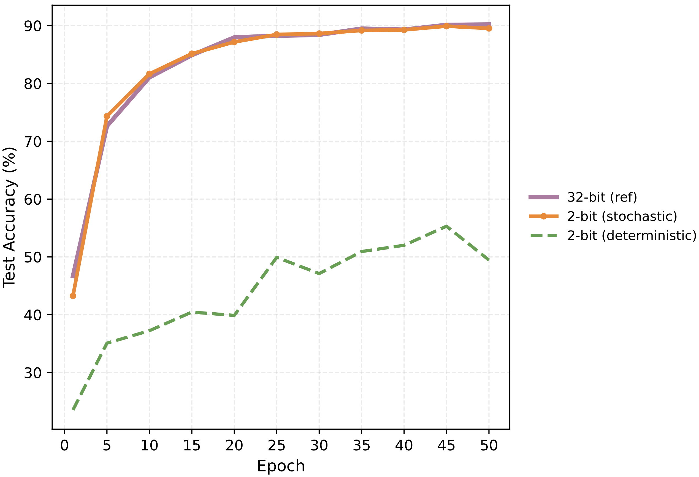
Stochastic Quantization of Activations for Backpropagation
Experiments: Stochastic vs. deterministic at low bits
Finding:
At 2-bit precision, unbiased stochastic rounding improves training stability and final accuracy relative to deterministic rounding, reducing the gap to the 32-bit reference dramatically.
Fig.12. 2-bit comparison: stochastic vs. deterministic activation quantization with 32-bit reference
Contribution #2

Slide 31
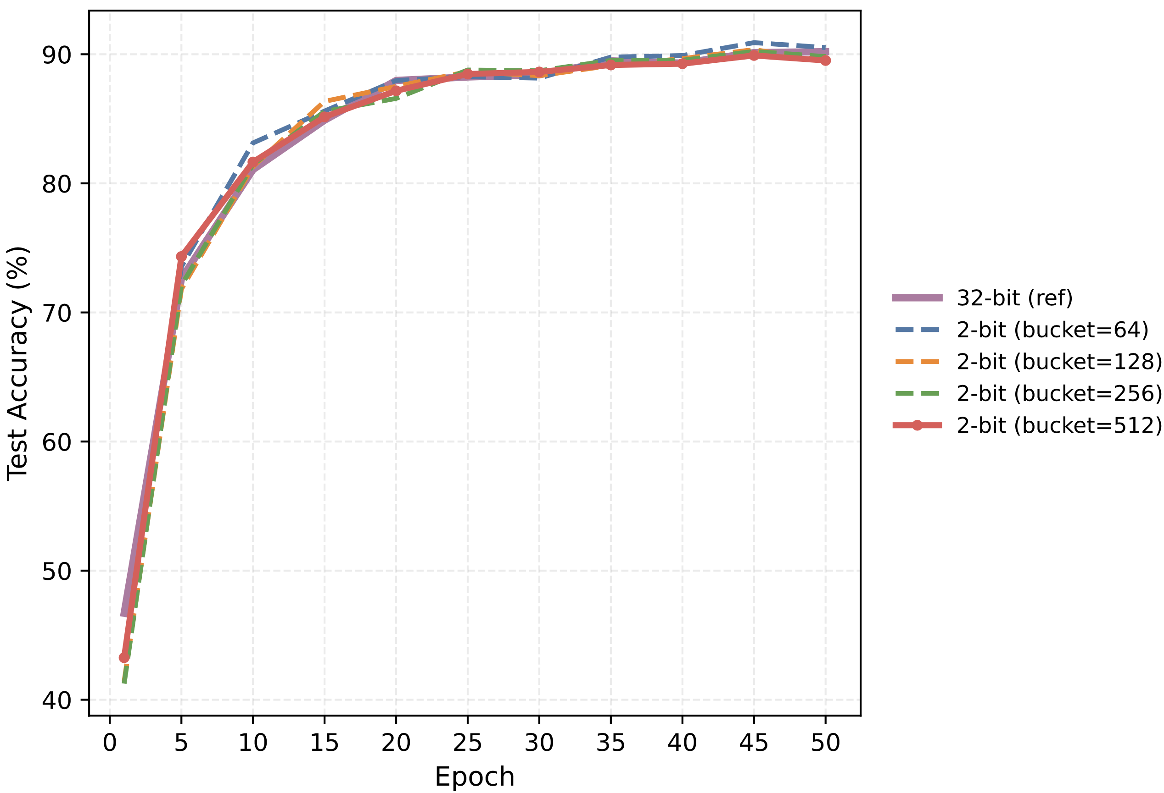
Stochastic Quantization of Activations for Backpropagation
Experiments: Bucket-size trade-off
Finding:
Smaller buckets provide more accurate per-bucket scaling and higher accuracy (both at 2-bit and 4-bit), at the cost of increased metadata and compute overhead; larger buckets reduce overhead with a small accuracy penalty.
Fig.13. 2-bit bucket size study (64, 128, 256, 512) with stochastic quantization vs. 32-bit reference.
Contribution #2

Slide 32
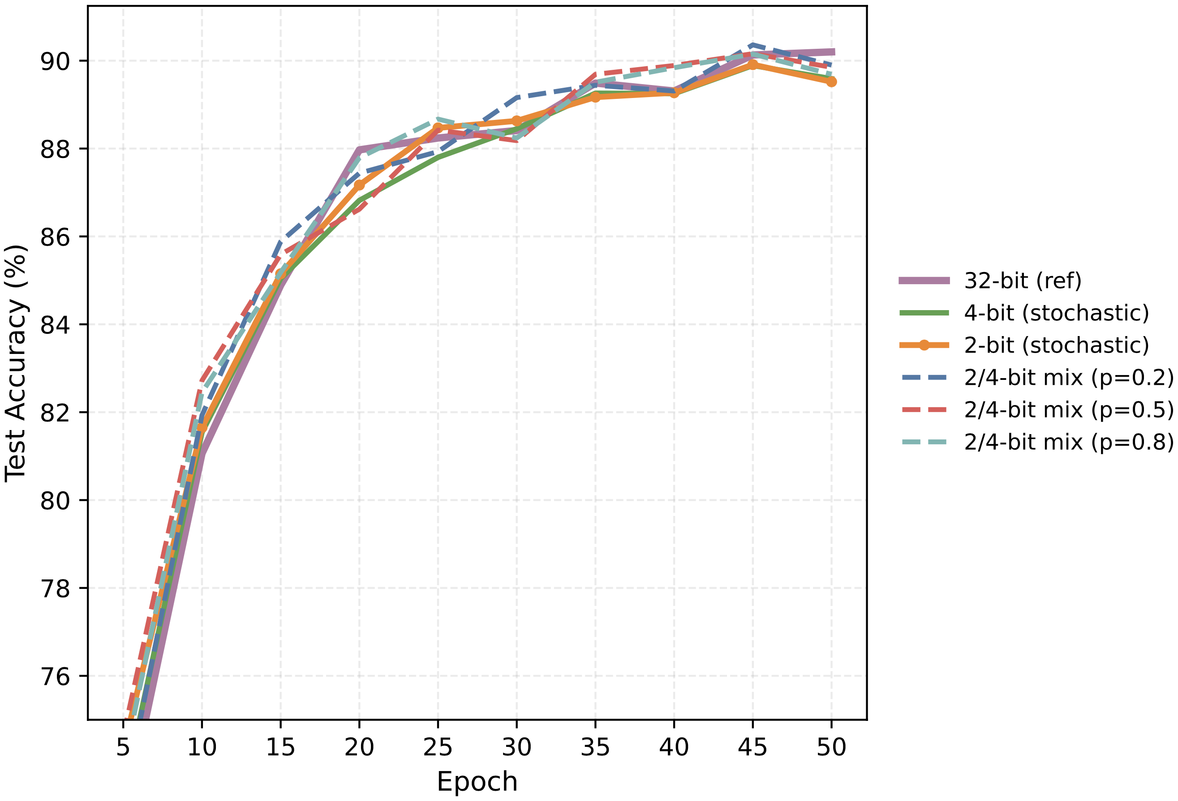
Stochastic Quantization of Activations for Backpropagation
Experiments: Mixed precision benefits
Finding:
When introducing 4-bit mixed precision to the 2-bit base quantization, all mixed-precision configurations (p=0.2, 0.5, 0.8) achieve slightly higher test accuracy than the pure 2-bit stochastic baseline, demonstrating that selective use of higher precision buckets enhances overall model performance while maintaining aggressive memory compression.
Fig.14. 2/4-bit mixed stochastic quantization at mixing probabilities 0.2/0.5/0.8 (bucket=512), compared against 2-bit, 4-bit stochastic baselines and 32-bit reference.
Contribution #2

Slide 33
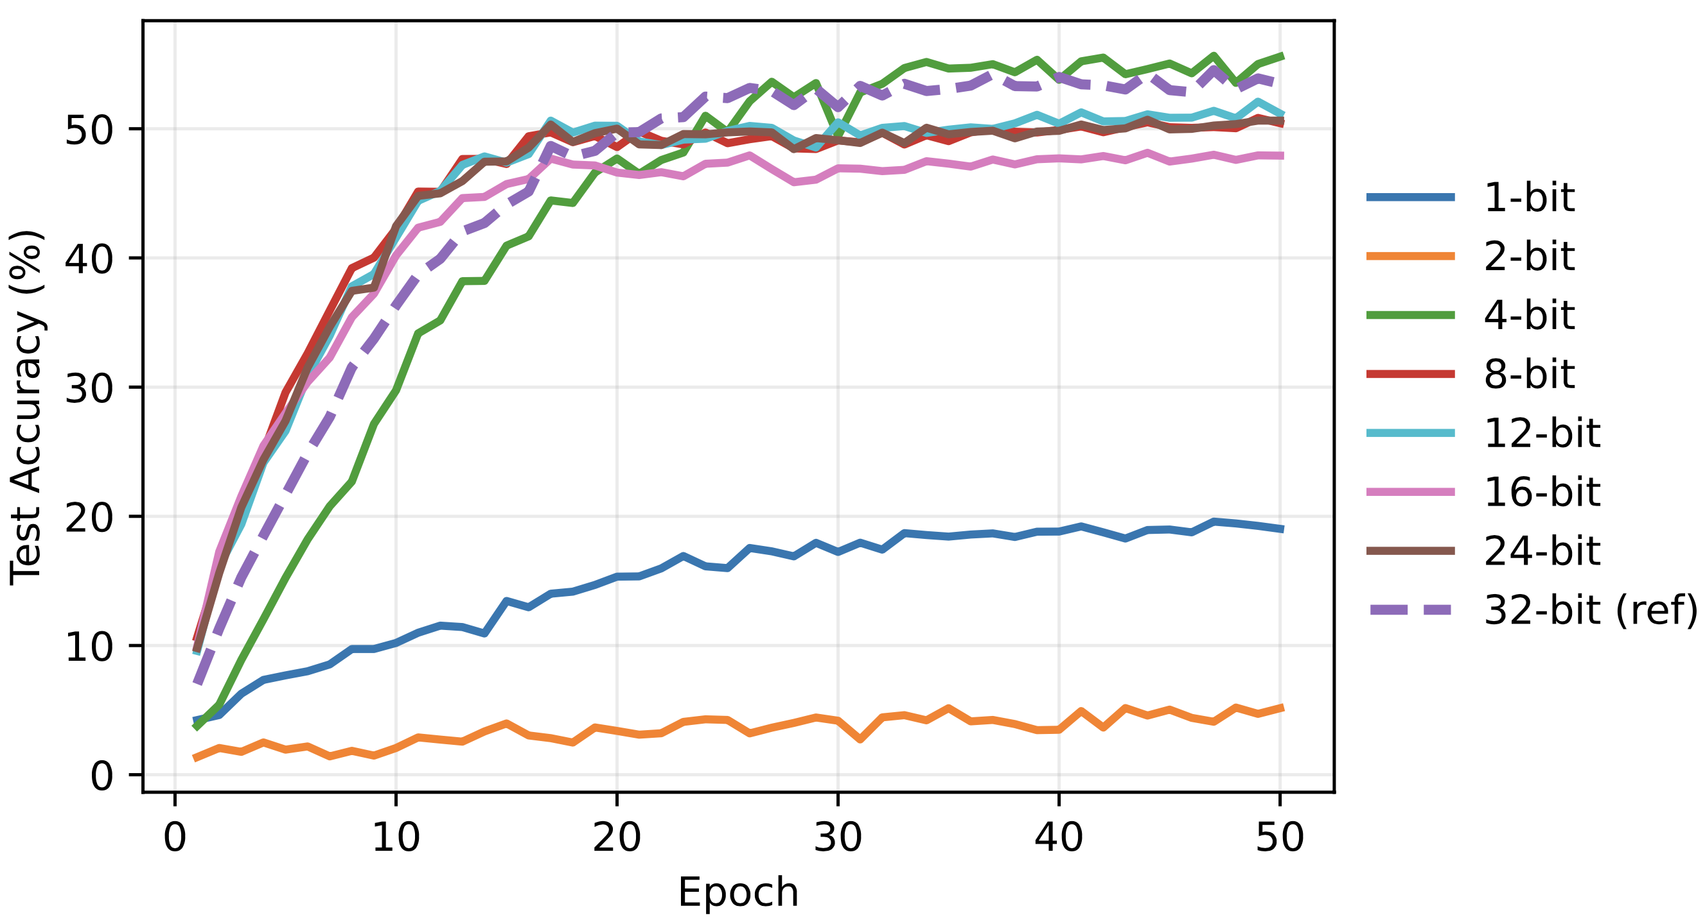
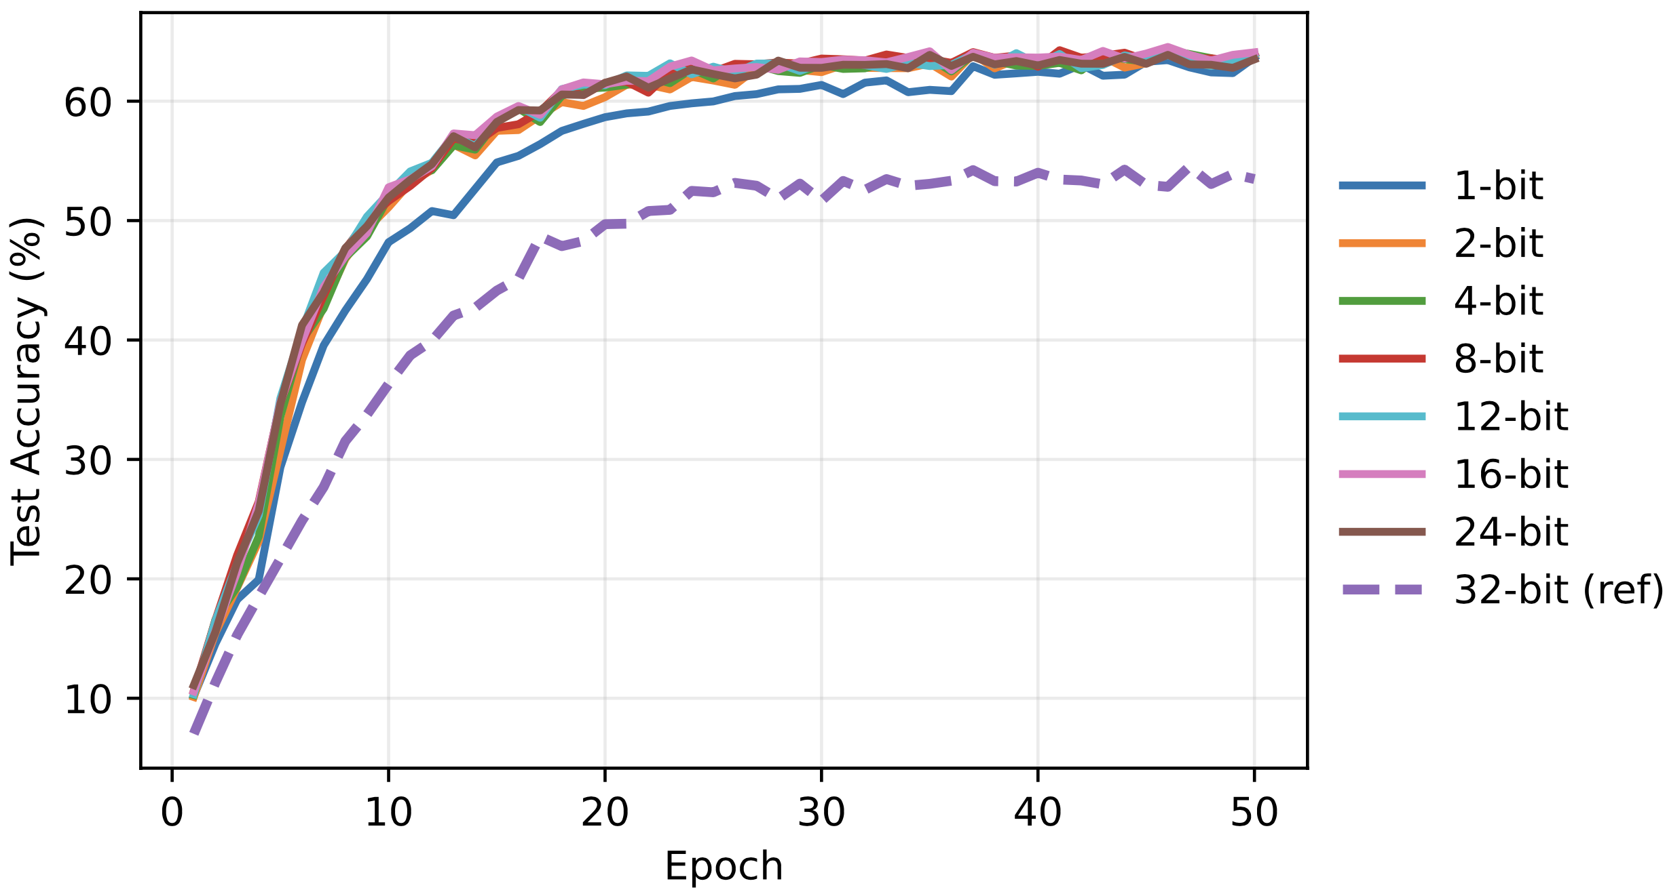
Generalization of Stochastic Activation Quantization
Experiments: CIFAR100 & Tiny ImageNet (ImageNet-200)
Fig.15. Left: CIFAR-100 (Brevitas, deterministic rounding): bit-width sweep;
Right: CIFAR-100 (stochastic, unbiased rounding): bit-width sweep
Finding:
Overall, stochastic activation quantization performs strongly on CIFAR-100: at matched bit-widths, it delivers higher final accuracy and more stable optimization than deterministic rounding. These results support the hypothesis that unbiased stochastic rounding, coupled with per-bucket scaling, generalizes beyond CIFAR-10 and remains effective on larger, more challenging datasets.
Contribution #3

Slide 34
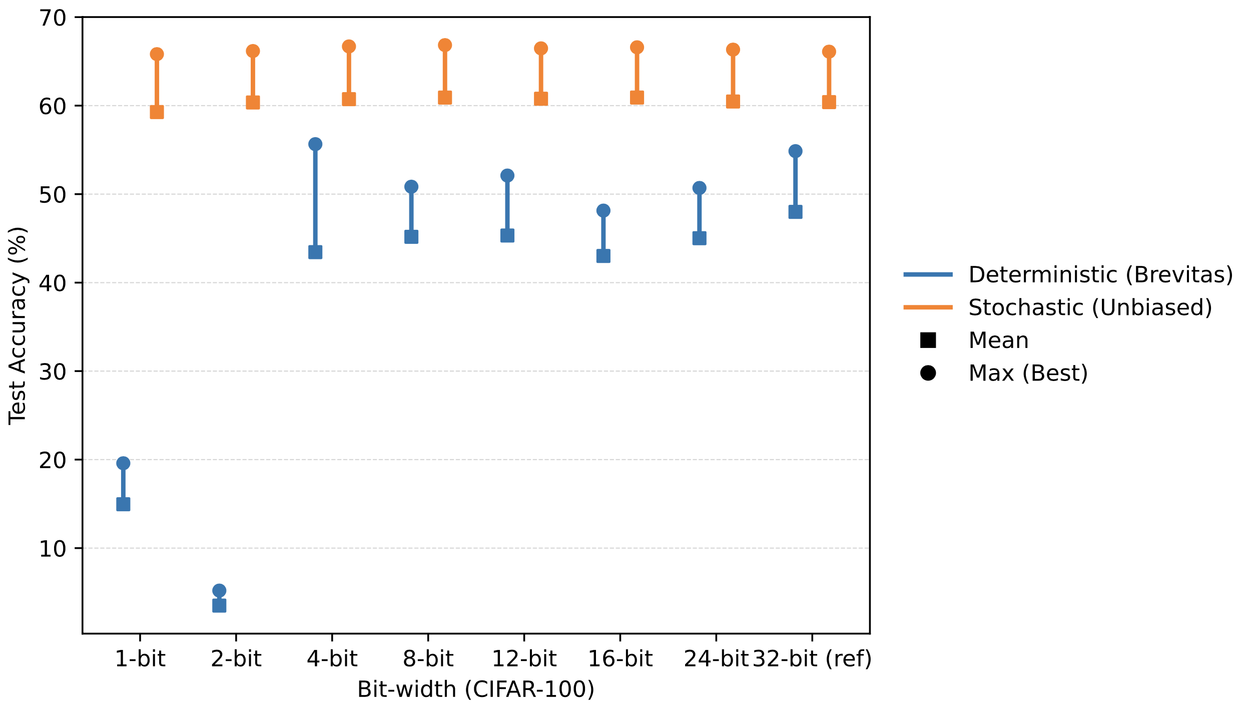
Generalization of Stochastic Activation Quantization
Experiments: CIFAR100 & Tiny ImageNet (ImageNet-200)
Finding:
Stochastic (unbiased) quantization demonstrates systematic and substantial performance improvements over deterministic (Brevitas) quantization across the entire bit-width spectrum on CIFAR-100, with enhanced accuracy and significantly improved training stability at every tested precision level.
Fig.16. CIFAR-100 deterministic (Brevitas) vs. stochastic (unbiased) comparison per bit-width.
Contribution #3

Slide 35
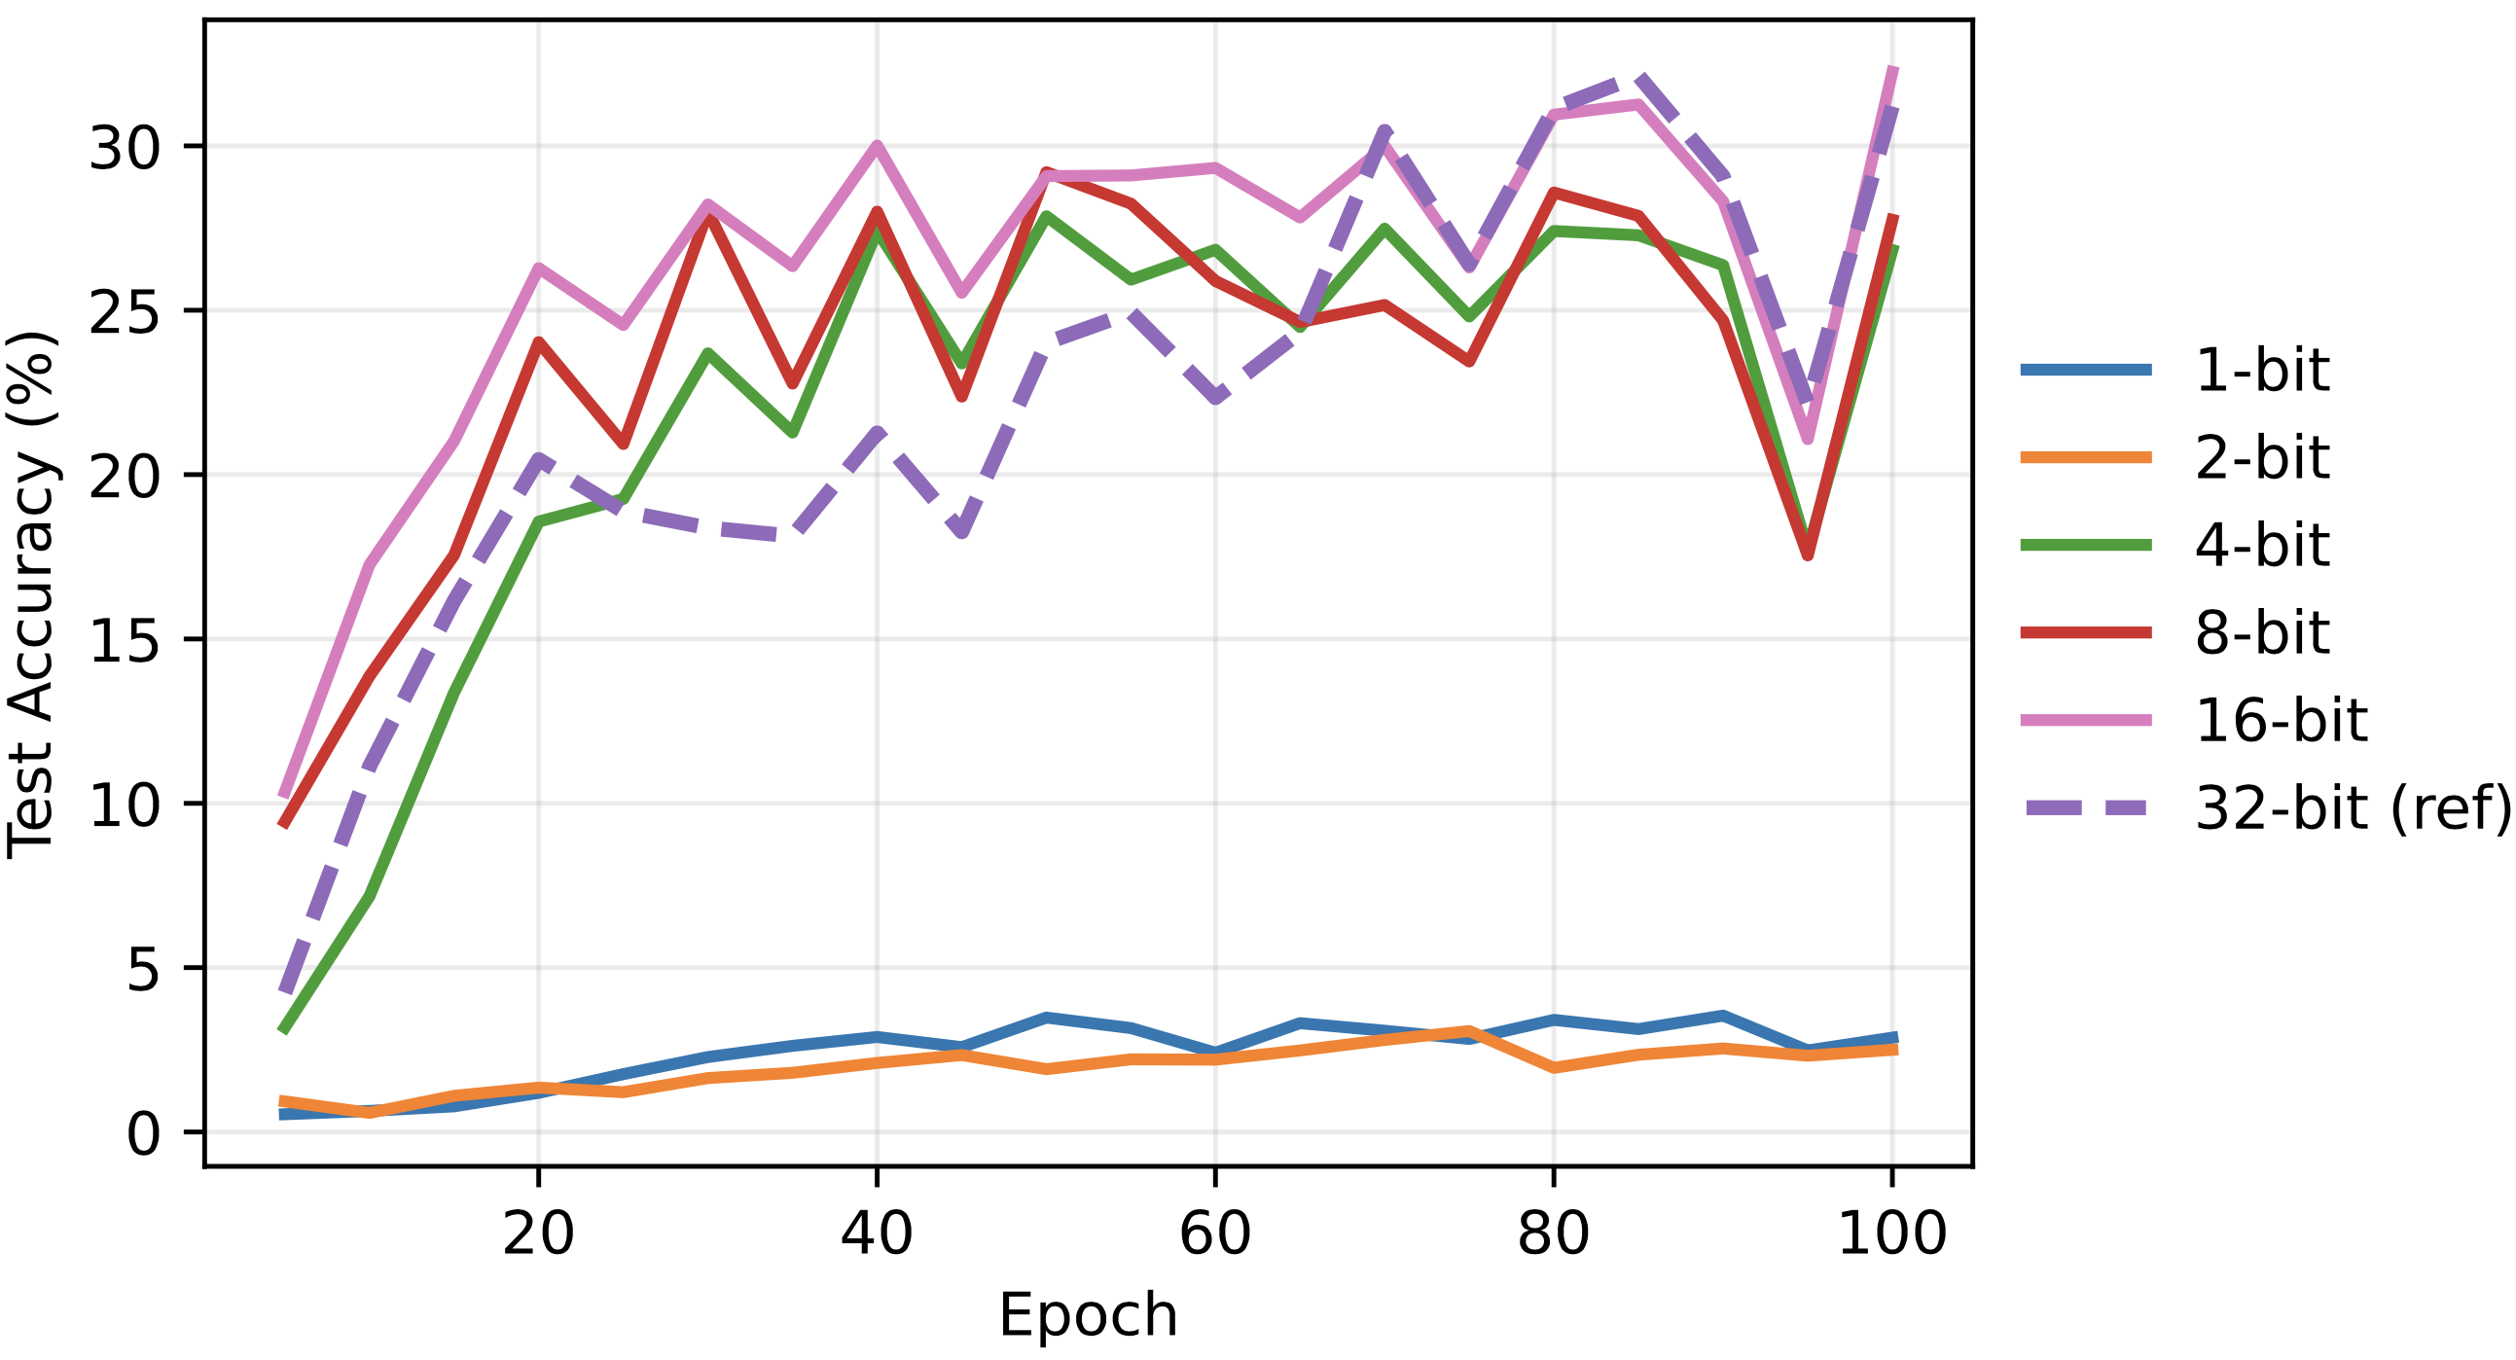
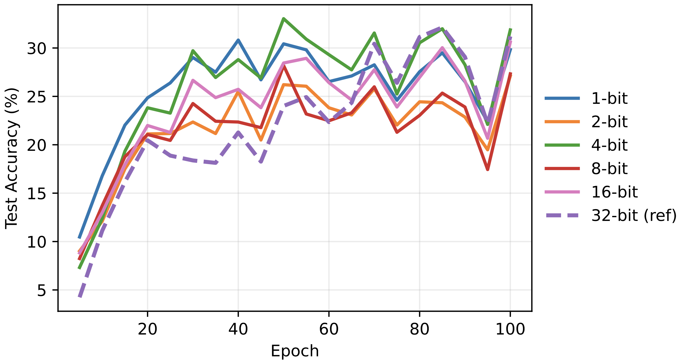
Generalization of Stochastic Activation Quantization
Experiments: CIFAR100 & Tiny ImageNet (ImageNet-200)
Fig.17. Left: Tiny ImageNet (ImageNet-200) with deterministic activation quantization across 1- 32 bits.
Right: Tiny ImageNet (ImageNet-200) with stochastic activation quantization across 1- 32 bits.
Findings:
1. Tiny ImageNet on EcientNetV2 exhibits noisy training dynamics: the test-accuracy trajectories fluctuate noticeably across epochs and bit-widths. This reflects that the FP32 baseline on this dataset/architecture is itself not fully stabilized, so absolute gaps between adjacent bit-widths are less reliable than on CIFAR-100.
2. The stochastic variant shows similar oscillatory behaviour, driven largely by the same baseline/optimization sensitivity on Tiny ImageNet.
Contribution #3

Slide 36
Discussion & Outlook

Slide 37
Discussion & Outlook
Two implementations of activation quantization for the backpropagation
Deterministic activation quantization for backpropagation using Brevitas
Stochastic activation quantization with per-bucket scaling
2. Quantitative Highlights
Low-bit stability and accuracy
On CIFAR-10 and CIFAR-100, 2-4-bit stochastic activation quantization consistently raises accuracy and smooths optimization relative to deterministic rounding at the same bit-width
Backprop-only memory savings.
Quantizing only the saved activations reduces training-time activation memory approximately in proportion to bit-width (∼ 8× at 4-bit; ∼ 16× at 2-bit), without altering forward computation. This enables larger batch sizes or training on smaller GPUs.
Per-bucket scaling.
Bucketed min/max scaling lowers quantization variance and clipping; smaller buckets benefit low-bit regimes at a modest metadata cost.
Mixed precision (arbitrary two-bit)
Mixed precision (arbitrary two-bit). The implementation supports arbitrary two-bit stochastic mixing via (base_levels, mix_levels) with a probability parameter mix_levels_prob, enabling tuneable accuracy memory trade-offs without kernel changes
Engineering efficiency
A vectorized kernel removes Python loops and performs bucket-level decisions in parallel, substantially reducing the overhead of the quantization step.
Discussion & Outlook

Slide 38
Discussion & Outlook
3. Limitation
On Tiny ImageNet (ImageNet-200), we observe noisier trajectories even at the 32-bit reference. This points to sensitivity to optimizer/schedule and backbone choice (EcientNetV2), rather than a quantization-specific artifact. While stochastic quantization remains competitive, absolute gaps across adjacent bit-widths should be interpreted with caution in this setting.
4. Future work
Stability on larger datasets
Strengthen stochastic quantization on larger or noisier datasets through (i) schedule search (e.g., warmup length; cosine vs. OneCycle), (ii) weight-decay tuning and gradient clipping, (iii) adaptive bucket sizing or EMA-based scale updates
Broader model coverage
Evaluate generalization across additional CNN families (e.g., ResNet/ConvNeXt/MobileNet) and extend to ViT/Transformer backbones by quantizing backward-sensitive tensors in attention and MLP blocks; report accuracy memory trade-offs across tasks.
Richer framework capabilities:
Extend the current design (arbitrary two-bit mixing) to multi-bit mixing with automatic per-layer bit selection under memory/accuracy constraints. An AutoML-style selector could assign (2/3/4/6/8)-bit per block to maximize memory savings while preserving accuracy.
Discussion & Outlook

Slide 39
References

Slide 40
References
Daniel Barley and Holger Froening. Less Memory Means Smaller GPUs: Backpropagation with Compressed Activations. In: arXiv preprint arXiv:2409.11902 (2024). url: https://arxiv.org/ abs/2409.11902.
Dan Alistarh, Demjan Grubic, Jerry Li, Ryota Tomioka, and Mi- lan Vojnovic. QSGD: Communication-Ecient SGD via Gradient Quantization and Encoding. In: Advances in Neural Information Processing Systems (NeurIPS). 2017. url: https://arxiv. org/abs/1610.02132.
Davide Cai and contributors. Brevitas: Quantization-Aware Training in PyTorch. GitHub repository. 2019. url: https://github. com/Xilinx/brevitas.
Ian Goodfellow, Yoshua Bengio, and Aaron Courville. Deep Learning. MIT Press, 2016. url: https://www.deeplearningbook. org/.
Benoit Jacob, Skirmantas Kligys, Bo Chen, Menglong Zhu, Matthew Tang, Andrew Howard, Hartwig Adam, and Dmitry Kalenichenko. Quantization and Training of Neural Networks for Efficient Integer- Arithmetic-Only Inference. In: arXiv preprint arXiv:1712.05877 (2018). url: https://arxiv.org/abs/1712.05877.
Raghuraman Krishnamoorthi. Quantizing Deep Convolutional Networks for Efficient Inference: A Whitepaper. In: arXiv preprint arXiv:1806.08342 (2018). url: https://arxiv.org/abs/1806. 08342.
Paulius Micikevicius et al. Mixed Precision Training. In: arXiv preprint arXiv:1710.03740 (2017). url: https://arxiv.org/ abs/1710.03740.
Bengio, Y., Léonard, N., & Courville, A. (2013). Estimating or propagating gradients through stochastic neurons for conditional computation. arXiv preprint arXiv:1308.3432.
Wang, K., Liu, Z., Lin, Y., Lin, J., & Han, S. (2019). HAQ: Hardware-Aware Automated Quantization with Mixed Precision. In: Proceedings of the IEEE/CVF Conference on Computer Vision and Pattern Recognition (CVPR), pp. 8612-8620.
Tan, M., & Le, Q. V. (2021). EfficientNetV2: Smaller Models and Faster Training. In: Proceedings of the 38th International Conference on Machine Learning (ICML), pp. 10096-10106.
Chen, J., Kao, R., Jain, P., Sohoni, N. S., Kidambi, R., Fatahalian, K., & Ré, C. (2021). ActNN: Reducing Training Memory Footprint via 2-Bit Activation Compressed Training. In: Proceedings of the 38th International Conference on Machine Learning (ICML), pp. 1803-1813.
References

Slide 41
Thank You!
Questions?

